Slide 1
Majlis Ansārullāh
Monthly Meeting
February 2025
Home of Love or Fear
We have to be kind and loving to our wives

Slide 2
AGENDA
Recitation and translation of the Holy Quran
Pledge
Hadith
Discussion Segment
Salat (Daily Prayers)
Al–Wasiyyat
Zahanat
Reading The Holy Quran
Health segment
Local Time – Missionary Comments/Reminders/Announcements
Du’a

Slide 3
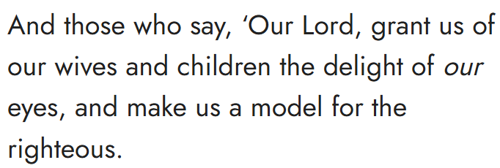
Recitation of the Holy Quran
Chapter 25, Al Furqan, Verse 75

Slide 4
Pledge
Say this part three times:
Ash-hadu • alla ilaha • illallahu • wahdahu • la sharika lahu • wa ash-hadu • anna Muhammadan • ‘abduhu • wa rasuluh
Say this part once:
I bear witness • that there is none worthy of worship • except Allah. • He is One • (and) has no partner, • and I bear witness • that Muhammad (peace be upon him) • is His servant • and messenger.
Say this part once:
I solemnly promise that • I shall endeavor • till the end of my life • for the consolidation • and propagation of Islām Ahmadiyyat • and for upholding • the institution of Khilafat. • I shall also be prepared • to offer the greatest sacrifice • for this cause. • Moreover, • I shall urge all my children • to remain true • to Khilafat Ahmadiyya. • Insha’Allah.

Slide 5
Hadith

Slide 6
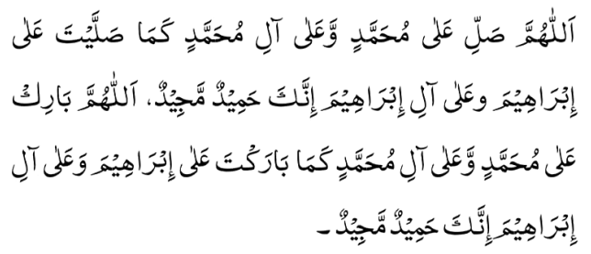
Hadith
O Allah, Bless Muhammad^{sa} and the people of Muhammad^{sa}, as Thou didst bless Abraham and the people of Abraham. Thou art indeed the Praiseworthy, the Glorious. Prosper, O Allah, Muhammad^{sa} and the people of Muhammad^{sa}, as Thou didst prosper Abraham and the people of Abraham. Thou are the Praiseworthy, the Glorious
Hadrat Abu Huraira^{ra} reported: The Prophet^{sa} said, “May Allah have mercy on a man who gets up at night and prays, and awakens his wife; if she refuses, he should sprinkle water on her face. May Allah have mercy on a woman who gets up at night and prays, and awakens her husband; if he refuses, she would sprinkle water on his face”.
Sunan Abi Dawud, Hadith #1308

Slide 7
The Holy Quran Discussion

Slide 8
Recitation of the Holy Quran
Chapter 25, Al Furqan, Verse 75

Slide 9
Discussion
One Nasir was harsh in his approach at his home. He had instructed his wife that he would want freshly prepared hot food ready when he gets home from work. He also expected his home to always be clean and tidy. His wife was always very busy cooking cleaning and taking care of the children in the evening. One night after dinner, he got up and was getting ready to leave. His wife wanted to know where was he going. He said, “I am going to go sit with my friends, you never have any time for me”.
Is his response acceptable?
Do you see anything wrong with this couple?

Slide 10
HKM V^{aba} Friday Sermon, May 19, 2017
Some men, thinking that they have unbridled authority as the head of the house, are engaged in domestic violence and cruelty to children. So, if one wants to carry on treating his wife and children like ignorant people, then there is no benefit in coming into the Bai’at [Oath of Initiation] of the Promised Messiah^{as}. The Holy Prophet^{sa}, as the guardian of his family, made his family appreciate first and foremost, the importance of establishing Tauheed [Oneness of God]. However, he did so with love and affection, not by force. Thus, Hazrat Aisha^{ra} relates that the Holy Prophet^{sa} would wake up during the night to offer nafl [voluntary] prayers and he would wake us up with a light sprinkling of water, so that we may offer nawafil and fulfil the responsibilities which are due to Allah. Then, the Holy Prophet^{sa} helped with tasks, which were part of the duties of the wives. Hazrat Aisha^{ra} relates that he would stitch his own clothes, mend his shoes and repair the household items such as the water bucket etc. Thus, many husbands, keeping these examples in mind, will have to re-evaluate their behavior at home. Remember the Hadith, “The one from among you is the highest regarding morals and manners who is better in his treatment of his wives.’ Thus, good treatment of wives is the very sign of the greatness of one’s standard of faith.

Slide 11
خطبہ جمعہ 19؍ مئی 2017ء فرمودہ حضرت مرزا مسرور احمد، خلیفۃ المسیح الخامس ایدہ اللہ تعالیٰ بنصرہ العزیز

Slide 12
HKM V^{aba} Friday Sermon, July 2nd, 2004
It has become a custom for men to say they have responsibilities of the house, and they are busy in their business and jobs so they cannot pay attention to the home and watching children is the responsibility of women. They should remember that as men and head of the family they are responsible to keep an eye on the household. A man should fulfil the rights towards his wife and children. He should spend time with them, even if it is only on the two days of the weekend. He should get them connected with the mosque and encourage them to participate in the Jama’at activities. He should arrange some recreational programs and should take interest in their activities so they can share their problems with him like a friend. He should talk to his wife and children about their problems and should help solve these issues; this is the only way he can have the status as the head of the family

Slide 13
Speech by Hazrat Khalifatul Masih V^{aba}
Majlis Ansarullah UK Annual Ijtima 2024
Huzoor^{aba} spoke at length about the importance of creating homes filled with love, affection, and peace, explaining that these virtues would flow from the home into society. He shared the guidance of the Promised Messiah^{as} on the respectful and kind treatment of women, reminding the ansar of an incident where the Promised Messiah^{as} had raised his voice slightly to his wife and then spent a long time in prayer, seeking forgiveness and offering charity. This anecdote served to highlight the high standard of conduct expected from ansar, particularly in their homes
“By the time you turn forty, you reach full maturity. It is also a time when some people do not control their emotions. They start feeling like they deserve more respect and honors. If there is ever a disagreement with their wives, it can lead to situations where husbands become harsh with them or even treat their wives’ close relationships unjustly. When a husband behaves in a way that his wife finds inappropriate, it has a negative impact. This leads to much tension and discomfort in the house, which ultimately impacts the children.”

Slide 14
Salat

Slide 15
Salat
Huzoor (May Allāh be his Helper) said: We all know that the Salāt has been
enjoined upon every Muslim and that the Holy Qur’ān is full of exhortations to this
effect. The Holy Prophet said that Salāt is the essence of worship and that forsaking salat brings one closer to infidelity and idolatry. The Holy Prophet said that children should be exhorted to offer Salāt when they are seven years old, and when they reach the age of ten, the parents can, if necessary, use strict measures to make them regular in Salāt.
Huzoor^{aba} said: Children hear these teachings about the importance of Salāt in various gatherings, but they have no effect on them if they go home and see that their own parents are not punctual in their prayers. Such children will think that these commandments are not important, and they will then start ignoring all Islāmic commandments. Such parents remain deprived and will also deprive their children. Parents often worry about the material desires and progress of their children, but have scant regard for the things that truly matter.
Friday Sermon delivered by Hazrat Khalifatul Masih V^{aba}, January 20th, 2017

Slide 16
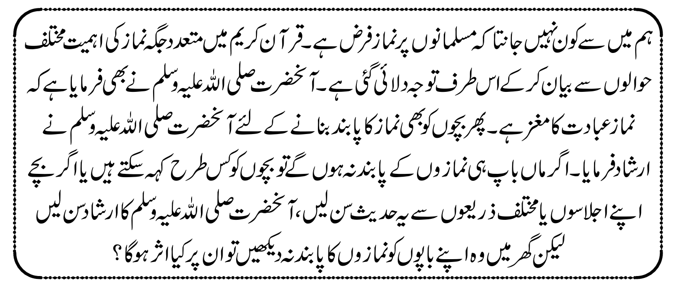
Salat
خطبہ جمعہ٢٠ دسمبر 2017ءفرمودہ حضرت مرزا مسرور احمد، خلیفۃ المسیح الخامس ایدہ اللہ تعالیٰ بنصرہ العزیز

Slide 17
Al-Wasiyyat

Slide 18
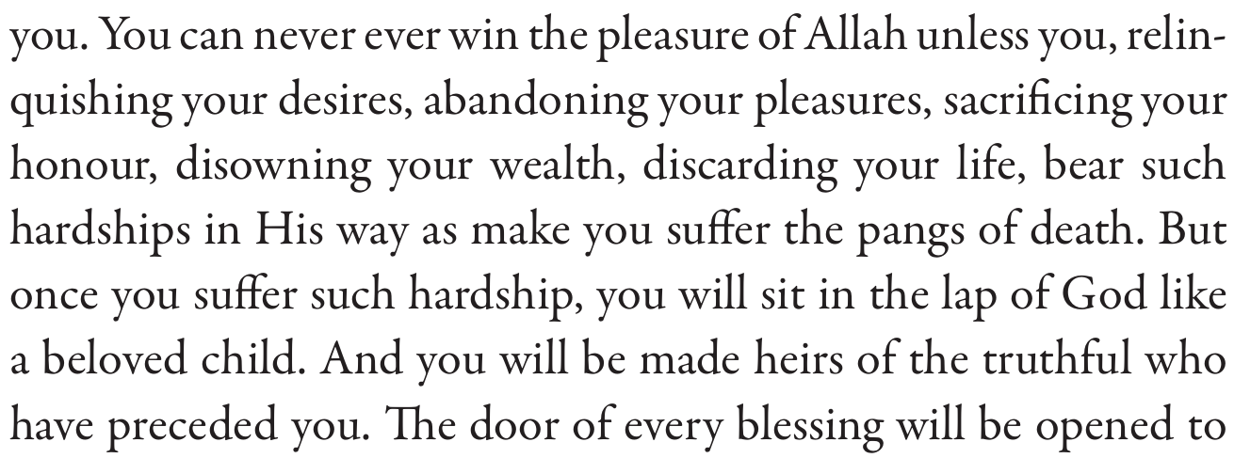
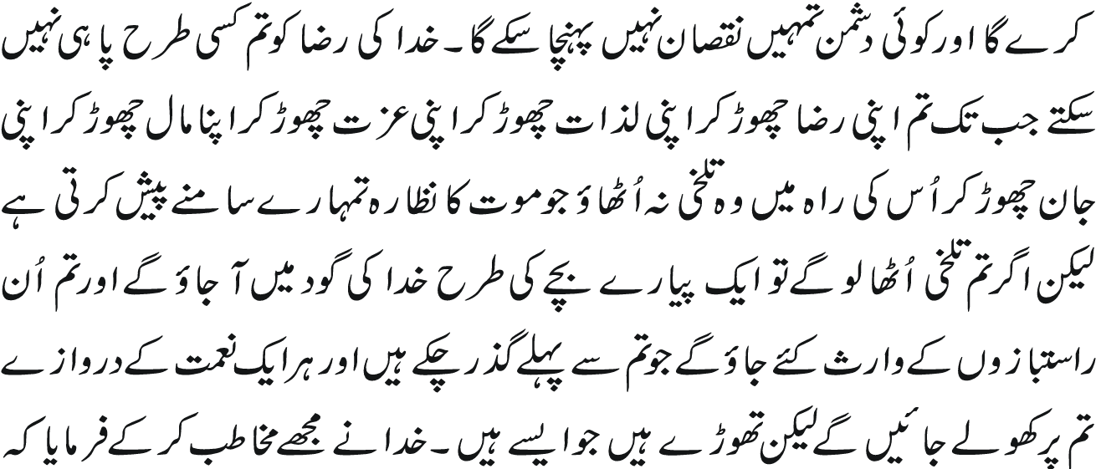
Al Wasiyyat
Al Wasiyyat

Slide 19
Zahanat
(Mental ability)

Slide 20
Zahanat
Q 1. What is the hardest natural substance on Earth?
Gold
Iron
Diamond
Quartz
Q 2. Which language has the most native speakers in the world?
English
Spanish
Chinese
Hindi
Q 3. Which country is the largest by land area?
Canada
China
Russia
United States

Slide 21
Zahanat
Q 1. What is the hardest natural substance on Earth?
Diamond
Diamond is the hardest naturally occurring substance found on earth. Diamonds also bend and reflect light and break it up into the colors of the rainbow, which is what gives them their sparkle.
Gold
Iron
Diamond
Quartz
Q 2. Which language has the most native speakers in the world?
English
Spanish
Chinese
Hindi
Chinese
1.3 Billion Native Speakers. Numbers vary widely — Ethnologue puts the number of native speakers at 1.3 billion native speakers, roughly 900 million of whom speak Mandarin — but there's no doubt it's the most spoken language in the world.
Q 3. Which country is the largest by land area?
Canada
China
Russia
United States
Russia
With a total area of 6,592,850 square miles (17,075,400 square km), Russia is the world's largest country. A distant second is Canada, with 3,855,103 square miles (9,984,670 square km).

Slide 22
Reading of the Holy Quran

Slide 23
Quran Tajweed Basics
Letter Rā (ر)Thick/Thin sounds
The Letter Rā can be pronounced thick(Tafkhīm) or thin(Tarqīq) based on certain conditions:
Rā Mutaharrik(vowelled) will be pronounced with thick or heavy sound if it bears Fat’hah or Dammah or its Tanwīn or Tashdīd.
Rā Mutaharrik(vowelled) will be pronounced with thin or light sound if it bears Kasrah or its Tanwīn or Tashdīd.
Play Audio
Or click here (Rā rule conti.)

Slide 24
Health

Slide 25
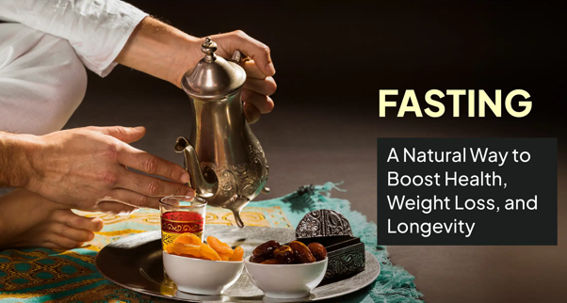
The Many Health Benefits of Fasting
Tanvir Ahmed Qaid Health

Slide 26
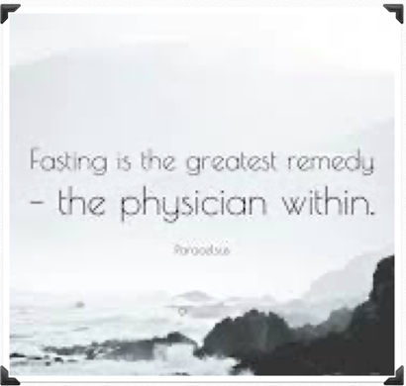
Fasting Quotes
Fasting is the greatest remedy - The physician within Philippous Paracelsus - Swiss Physician
Humans live on one-quarter of what they eat; on the other three-quarters lives their doctors (Egyptian Pyramid Inscription 3800 BC)

Slide 27
Many benefits of Fasting
A Longer Life, Leaner Body and Sharper Mind
New England Journal of Medicine
Fasting can protect organs against diabetes, heart disease, age-related neurodegenerative disorders inflammatory bowel disease and many cancers

Slide 28
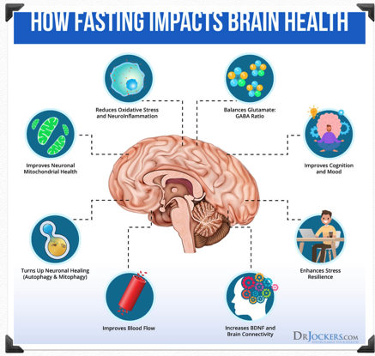
Many benefits of Fasting
Thinking and memory Studies discovered that intermittent fasting boosts memory in both humans and animals
Heart health Intermittent fasting improved blood pressure and resting heart rates as well as other heart-related measurements

Slide 29
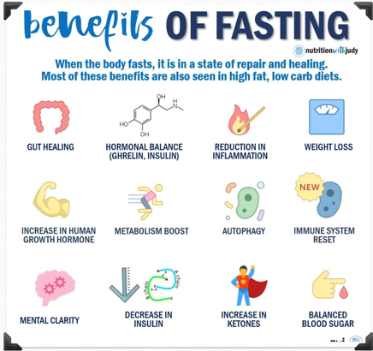
Many benefits of Fasting
Physical performance. Young men who fasted for 16 hours showed fat loss while maintaining muscle mass
Tissue health. Intermittent fasting reduced tissue damage in surgery and improved results (Animal Model)

Slide 30
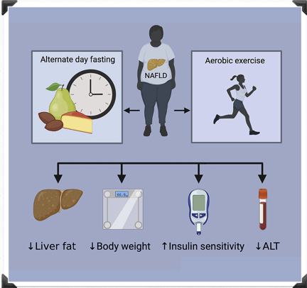
Many benefits of Fasting
Fasting Promotes Weight loss in obese adult humans
Diabetes Mellitus Fasting can lower levels of fasting glucose, fasting insulin and leptin while reducing insulin resistance etc.
Some patients may can get rid of their insulin. Talk to your doctor

Slide 31
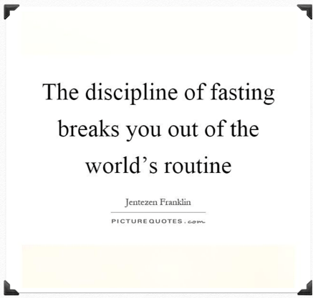
Who should not fast
Children
Women who are pregnant or breastfeeding.
People with type 1 diabetes who take insulin
People with eating disorder

Slide 32
Local Majlis Time
Sign-up for TAQWA Quran classes via the following link https://www.altaqwa.us/registration/
Sign-up for Waqf e Ardhi via the following link https://tinyurl.com/WaqfeArdhiSignup
Murabbi Sahib’s Comments
Reminders/announcements
Du’a
Adjourn
Waqf e Ardhi Sign-up
Jazakumullah for Participating!
If you enjoyed it, please convey to those brothers who are not here today!
Please take a moment to provide your feedback
https://tinyurl.com/TalimDeckFeedback
Feedback

