Slide 1
Majlis Ansārullāh
Monthly Meeting
August 2024
Where is Jesus^{as}?
This slide deck contains images licensed for the purpose of this presentation only.
No one is permitted to use the images for any other use, without prior permission.

Slide 2
Agenda
Recitation and translation of the Holy Quran
Pledge
Hadith
Discussion segment
Salat (Daily Prayers)
Al–Wasiyyat
Zahanat
Reading The Holy Quran
Health segment
Local Time – Missionary Comments/Reminders/Announcements
Du’a

Slide 3
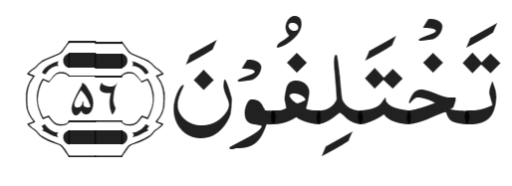
Recitation of the Holy Quran
When Allah said, ‘O Jesus, I will cause thee to die a natural death and will exalt thee to Myself and will clear thee from the charges of those who disbelieve and will place those who follow thee above those who disbelieve, until the Day of Resurrection; then to Me shall be your return, and I will judge between you concerning that wherein you differ.
Chapter 3, Verse 56

Slide 4
Pledge
Say this part three times:
Ash-hadu • alla ilaha • illallahu • wahdahu • la sharika lahu • wa ash-hadu • anna Muhammadan • ‘abduhu • wa rasuluh
Say this part once:
I bear witness • that there is none worthy of worship • except Allah. • He is One • (and) has no partner, • and I bear witness • that Muhammad (peace be upon him) • is His servant • and messenger.
Say this part once:
I solemnly promise that • I shall endeavor • till the end of my life • for the consolidation • and propagation of Islām Ahmadiyyat • and for upholding • the institution of Khilafat. • I shall also be prepared • to offer the greatest sacrifice • for this cause. • Moreover, • I shall urge all my children • to remain true • to Khilafat Ahmadiyya. • Insha’Allah.

Slide 5
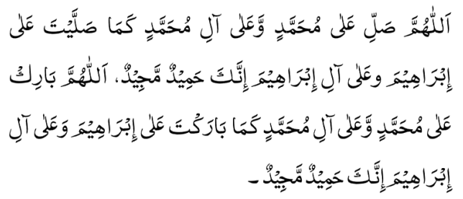
Hadith
O Allah, Bless Muhammad^{sa} and the people of Muhammad^{sa}, as Thou didst bless Abraham and the people of Abraham. Thou art indeed the Praiseworthy, the Glorious. Prosper, O Allah, Muhammad^{sa} and the people of Muhammad^{sa}, as Thou didst prosper Abraham and the people of Abraham. Thou are the Praiseworthy, the Glorious
Narrated ‘Aisha^{ra}: Allah’s Messenger^{sa} died while Abu Bakr^{ra} was at a place called As-Sunah (Al-‘Aliya) ‘Umar^{ra} stood up and said, “By Allah! Allah’s Messenger^{sa} is not dead!” ‘Umar^{ra} (later on) said, “By Allah! Nothing occurred to my mind except that.” He said, “Verily! Allah will send him and he will cut the hands and legs of some men.” Then Abu Bakr^{ra} came and uncovered the face of Allah’s Messenger^{sa}, kissed him and said, “Let my mother and father be sacrificed for you, (O Allah’s Messenger^{sa}), you are good in life and in death. By Allah in Whose Hands my life is, Allah will never make you taste death twice.” Then he went out and said, “O oath-taker! Don’t be hasty.” When Abu Bakr spoke, ‘Umar sat down. Abu Bakr praised and glorified Allah and said, No doubt! Whoever worshipped Muhammad, then Muhammad is dead, but whoever worshipped Allah, then Allah is Alive and shall never die.” Then he recited Allah’s Statement.: “(O Muhammad) Verily you will die, and they also will die.” (39:31) He also recited:
“Muhammad is no more than an Apostle; and indeed the Apostles have passed away, before him, If he dies Or is killed, will you then Turn back on your heels? And he who turns back On his heels, not the least Harm will he do to Allah And Allah will give reward to those Who are grateful.” (3:145).
(Sahih Al-Bukhari, the Book about the Virtues of the Companions of the Prophet^{sa})

Slide 6
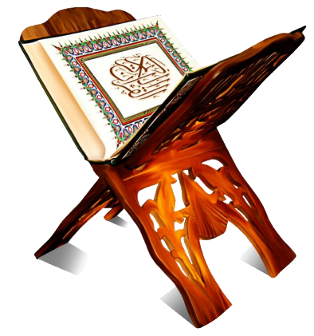
Discussion Segment
Suggested Time 15 mins

Slide 7
Recitation of the Holy Quran
When Allah said, ‘O Jesus, I will cause thee to die a natural death and will exalt thee to Myself and will clear thee from the charges of those who disbelieve and will place those who follow thee above those who disbelieve, until the Day of Resurrection; then to Me shall be your return, and I will judge between you concerning that wherein you differ.
Chapter 3, Verse 56

Slide 8
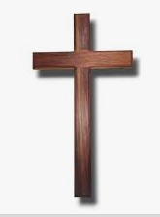
Understanding the verses
You were sitting among your friends discussing the attributes of Allah the Almighty. You mentioned that Allah is the all powerful and whenever He wants, He says “Be; and it is”. One non-Ahmadi friend asked a question, ”If God is so powerful, how come you do not believe in physical ascension of Prophet Jesus^{as} when most Muslims believe in it?”.
How would you answer this question from the Holy Quran?

Slide 9
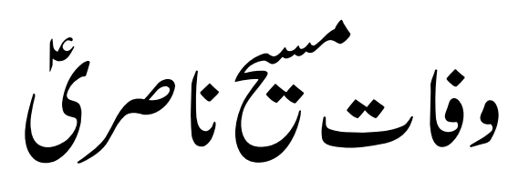
Recitation of the Holy Quran
DEATH OF JESUS OF NAZARETH
Izalae Auhaam, part 2, page 765, 1891
Son of Mary has passed away, by God,
That noble one has entered the Paradise.
The Quran fully asserts to his death;
It informs of his passing away.
He has not remained outside of mortality;
It has been proved by the thirty verses.

Slide 10
Understanding the verses
Some verses and their explanation

Slide 11
Recitation of the Holy Quran
Allah caused Jesus to die. Clear proof of his death 3:56
When Allah said, ‘O Jesus, I will cause thee to die a natural death and will exalt thee to Myself and will clear thee from the charges of those who disbelieve and will place those who follow thee above those who disbelieve, until the Day of Resurrection; then to Me shall be your return, and I will judge between you concerning that wherein you differ.
Chapter 3, Verse 56
Proof: The word mutawaffeeka means “I will cause you to die”. Whenever God is the fa’il (subject) and man is the maf’ul (object), it always refers to death. It means that God takes the soul of the man. In this case, it applies to Jesus^{as} which in turn means that he has passed away.

Slide 12
Understanding the verses
Jesus did not die an accursed death on the cross but met a dignified death (4:159)
On the contrary, Allah exalted him to Himself. And Allah is Mighty, Wise. [4:159]
Proof: This means that Jesus Christ^{as} did not suffer an accursed death by dying on the cross. Instead, God exalted him to Himself. The word rafa’a here refers to a kind of death which is dignified and exalted. The same word has been used in reference to Hazrat Idrees^{as} in reference to the exaltation of his status (see 19:58).

Slide 13
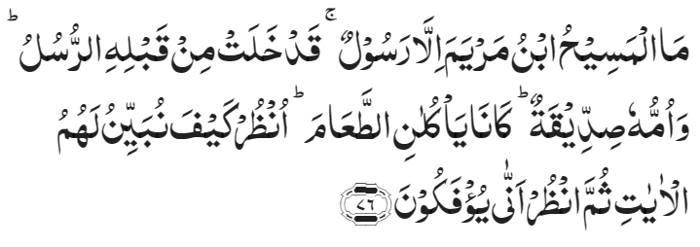
Understanding the verses
Jesus does not eat food anymore and the Prophets can’t survive without eating. (5:76, 21:9)
The Messiah, son of Mary, was only a Messenger; surely, Messengers like unto him had indeed passed away before him. And his mother was a truthful woman. They both used to eat food. [5:76]
Proof: It is clearly stated that both Jesus^{(as)} and his mother no longer eat food as understood from the Arabic word kaanaa, which is for past tense. Just as Mary^{as} no longer eats food and has died, the same applies to Jesus^{as}.
And We did not give them bodies that ate no food [21:9]
Proof: No physical body can remain without food. This is the practice of God. Why should we believe Jesus^{as} to be an exception to this?

Slide 14
Understanding the verses
Only three phases of life of Prophet Jesus^{as} 19:34
And peace was on me the day I was born, and peace there will be on me the day I shall die, and the day I shall be raised up to life again. [19:34]
Proof: There are only three episodes mentioned here for Jesus^{as}, namely, his birth, death, and life in the hereafter. If his physical ascent to heaven and physical descent from heaven were supposed to occur, they should have been mentioned here.

Slide 15
Understanding the verses
Jesus was worshiped by Christians. This proves he is dead 16:21-22
And those on whom they call beside Allah create not anything, but they are themselves created. [16:21]
They are dead, not living; and they know not when they will be raised. [16:22]
Proof: All those persons who are considered ‘gods’ according to these verses are dead. Jesus Christ^{as} is also believed to be god and he is dead.

Slide 16
Understanding the verses
Jesus not given unusually long/everlasting life 21:35
We granted not everlasting life to any human being before thee. If then thou shouldst die, shall they live here for ever? [21:35]
Proof: This verse explains that all people are subject to only one Way of God. No one has escaped death, nor will anyone escape death in the future. Everyone gets old and eventually dies, and Jesus Christ^{as} is not an exception to this rule.

Slide 17
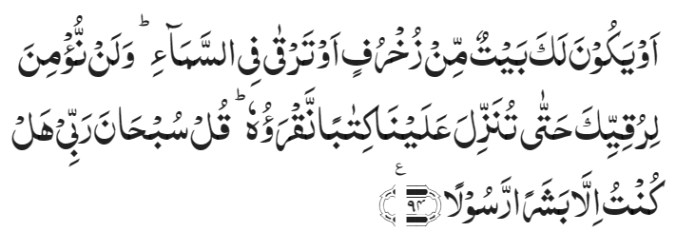
Understanding the verses
Human prophets can’t bodily ascend to the heaven 17:94
‘Or thou ascend up into heaven’…Say, ‘Holy is my Lord! I am not but a man sent as a Messenger.’ [17:94]
Proof: The disbelievers had asked the Holy Prophet^{sa} to raise himself to heaven and they were told through Divine revelation that it is not the Way of God to raise a human body to heaven. If we are to suppose that Jesus Christ^{as} did rise bodily to heaven, it would render the reasoning of this verse invalid and lead to a contradiction in the Holy Quran. Hence, the purely established truth in this matter is that Jesus Christ^{as} did not go to heaven in his physical body. Instead, he died, and his soul went to heaven.

Slide 18
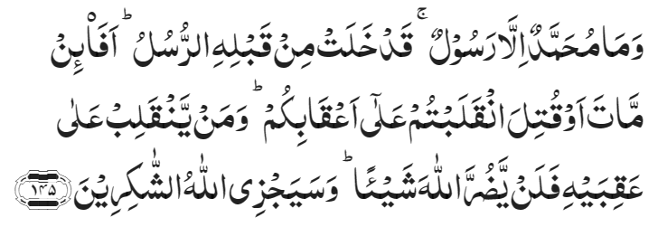
Understanding the verses
Jesus was a prophet preceding prophet Muhammad^{sa}, hence he is dead 3:145
And Muhammad is only a Messenger. Verily, all Messengers have passed away before him. If then he die or be slain, will you turn back on your heels?. And Allah will certainly reward the grateful. [3:145]
Proof: The reasoning of this verse is as follows: If it is necessary for a Prophet to live forever in this world, then present an example of such a Prophet from the past. If Jesus^{as} were considered as an exception to this, the verse will lose its meaning.

Slide 19
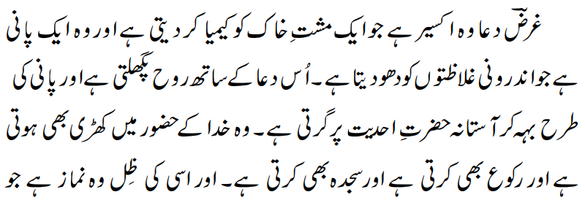
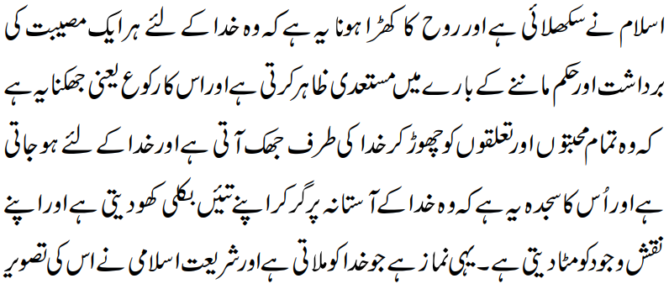
Salat
In short, prayer is that sovereign remedy which converts a handful of dust into precious metal. It is the water which washes out inner impurities. With such prayer, the soul melts and, flowing like water, falls at the threshold of the Divine. It stands before God and bows down before Him and prostrates itself before Him. Indeed, the Salat that Islam teaches is a reflection of such prayer. The standing of the soul in prayer is that it is prepared to endure every misfortune for the sake of God and is eager to carry out His commands, and its bowing down means that, discarding all other loves and relationships, it leans towards God and becomes His; and its prostration is that, falling at the threshold of God, it loses itself altogether and wipes out its own being. This is the Salat which brings about a meeting between God and the worshipper. The Islamic law depicts its picture in the shape of the daily Salat so that the physical Salat should urge a worshipper towards the spiritual Salat.
Lecture Sialkot, Ruhani Khaza’in, vol. 20, pp. 222-224

Slide 20
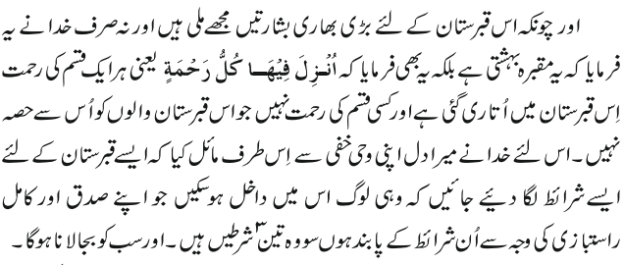
Al Wasiyyat
Since great tidings have been given to me about this graveyard and because God did not only say that this graveyard is Bahishti, but also said
that is, every kind of blessing has been sent down upon this graveyard and there is no blessing which is not shared by those who are buried in this graveyard, God has inclined my heart through His Wahi-e-Khafi towards the idea that for the burial in the graveyard some conditions should be prescribed and only those should get admittance who, because of their truthfulness and their perfect righteousness, comply with them.

Slide 21
Zahanat
What is the strongest muscle in the human body?
Biceps
Quadriceps
Heart
Jaw Muscle
What is the fastest land animal?
Cheetah
Ostrich
Lion
Deer
What is a group of crows called?
A pack
A flock
A murder
A caw

Slide 22
Zahanat
What is the strongest muscle in the human body?
Biceps
Quadriceps
Heart
Jaw Muscle (The Masseter)
The Masseter
The masseter a primary muscle of mastication and it is one of the strongest of human muscles.
What is the fastest land animal?
Cheetah
Ostrich
Lion
Deer
Per the Encyclopedia Brittanica, capable of going from 0 to 60 miles per hour in less than three seconds, the cheetah is considered the fastest land animal.
What is a group of crows called?
A pack
A flock
A murder
A caw
Murder
A group of crows is called a “murder.” There are several different explanations for the origin of this term, mostly based on old folk tales and superstitions. For instance, there is a folktale that crows will gather and decide the capital fate of another crow.

Slide 23
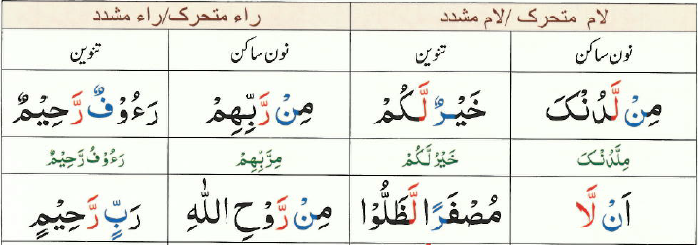
Quran Tajweed Basics
Noon Sakin – Idgham without Ghunnah
In Tajweed, Idgham means to merge one letter into another. If Noon Sakin(نٌ) and Tanween are followed by Lām or Rā Mashaddad (رّ,لّ) then a complete Idgham(merge) without nasal sound is made. The Noon and Tanween sounds should be completely eliminated.
A Common mistake while calling Azaan: (Ash-hadu an la ilaha illa-llah)
Correct: (Ash-hadu alla ilaha illa-llah)
Click here for a short video

Slide 24
Health

Slide 25
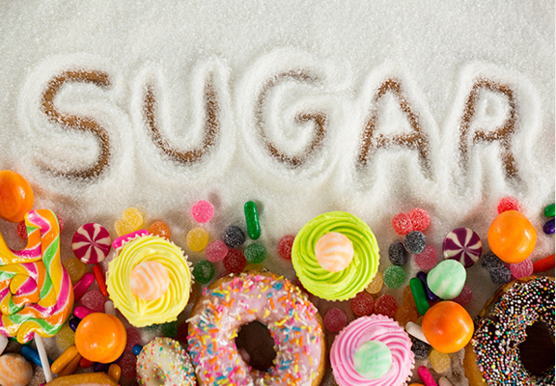
SUGARS AND ADDED SUGARS
Tanvir Ahmed

Slide 26
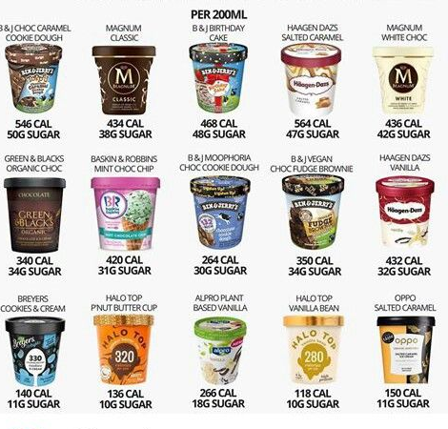
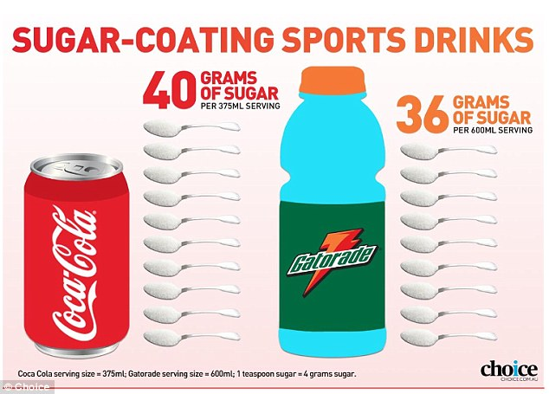
SUGAR ADDICTION
Sugar activates the reward and pleasure centers of our brains the same way addictive substances do.

Slide 27
REDUCE Free sugars
Free sugars are simple sugars added to foods by the manufacturer or consumer.
Free sugars DO NOT INCLUDE sugars naturally found in dairy (milk), structurally whole fruits and vegetables
Watch for sugar labels which may say glucose, sucrose, maltose, corn syrup honey, invert sugar, hydrolyzed starch and fructose

Slide 28
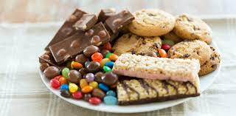
Sugars & Cardiovascular Disease
The more free sugar you eat, the more the risk of heart disease and stroke
High Sugars are also linked with high Triglycerides (TG) a kind of fat that comes from butter, oils etc.
High Triglycerides increase risk of heart disease

Slide 29
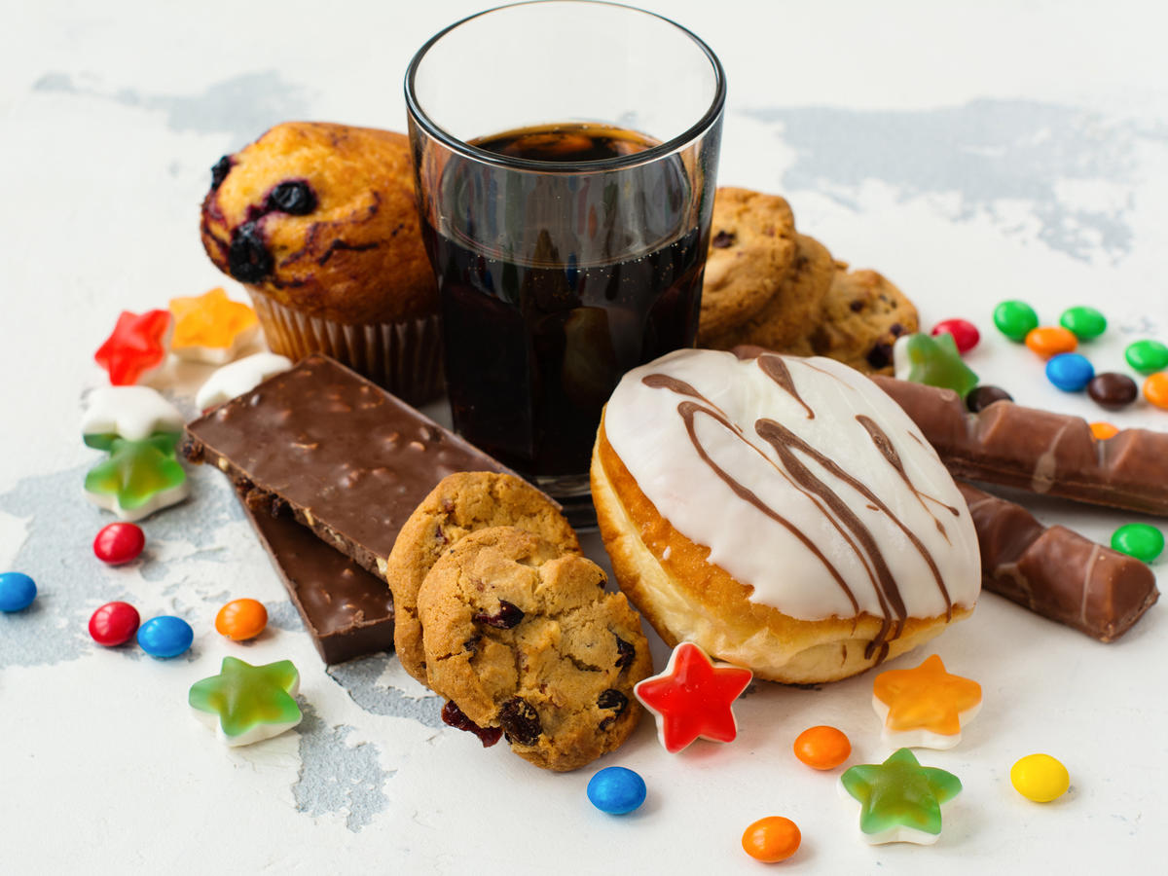
Inflammation and disease
ADDED SUGAR intake can promote inflammation in the body and this stresses the heart and the blood vessels leading to high blood pressure
Added Sugars are found in processed foods which have little nutritional value, leading to overeating and excess calorie intake > to obesity > Heart Disease

Slide 30
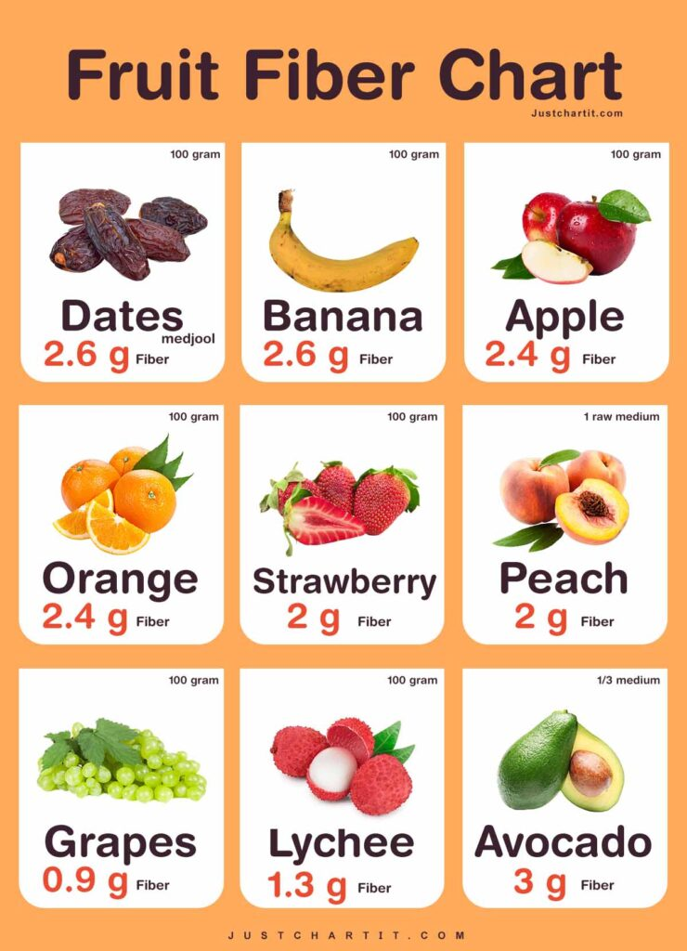
What can I do
Replace Free Sugars with non-free sugars found in whole fruits and vegetables
Whole intact grains don't cause the same spike in blood sugars as do free sugar containing foods
Fibers in whole foods clean up our bowels and slow sugar absorption. Intake should be at least 25 gm daily
Watch what you buy and eat, particularly breads cereals, flavored yogurts which contain high added sugars

Slide 31
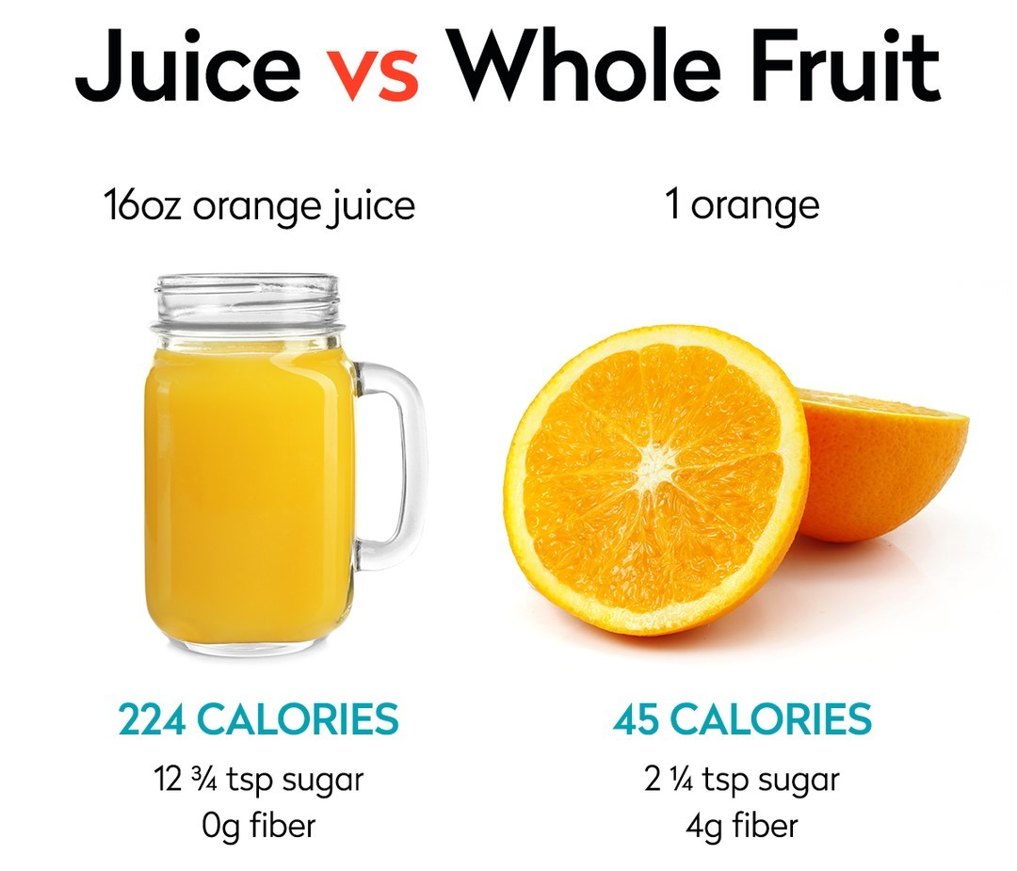
What can I do
Choose fresh fruits instead of ice creams, cakes, cookies, and juices for deserts
Fiber rich food keep you full reducing hunger
Cooking at home is the key instead of eating out
Drink water not juices, cokes and sodas
Remember to get good sleep
Exercise Regularly
Reduce stress

Slide 32
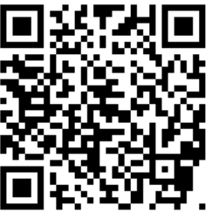
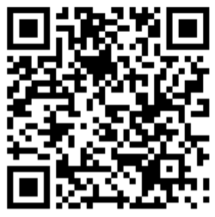
Local Majlis Time
Sign-up for TAQWA Quran classes via the following link https://www.altaqwa.us/registration/
Sign-up for Waqf e Ardhi via the following link https://tinyurl.com/WaqfeArdhiSignup
Murabbi Sahib’s Comments
Reminders/announcements
Du’a
Adjourn
Waqf e Ardhi Sign-up
Jazakumullah for Participating!
If you enjoyed it, please convey to those brothers who are not here today!
Please take a moment to provide your feedback
https://tinyurl.com/TalimDeckFeedback
Feedback

