Slide 1
Majlis Ansārullāh
Monthly Meeting
July 2024
“KHATAMUN-NABIYYEEN (Seal of the Prophets)”
This slide deck contains images licensed for the purpose of this presentation only.
No one is permitted to use the images for any other use, without prior permission.

Slide 2
Agenda
Recitation and translation of the Holy Quran
Pledge
Hadith
Discussion segment
Salat (Daily Prayers)
Al–Wasiyyat
Zahanat
Reading The Holy Quran
Health segment
Local Time – Missionary Comments/Reminders/Announcements
Du’a

Slide 3
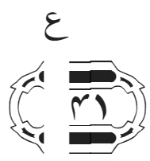
Recitation of the Holy Quran
Muhammad is not the father of any of your men, but he is the Messenger of Allah and the Seal of the Prophets; and Allah has full knowledge of all things.
Chapter 33, Verse 41
And whoso obeys Allah and this Messenger of His shall be among those on whom Allah has bestowed His blessings, namely, the Prophets, the Truthful, the Martyrs, and the Righteous. And excellent companions are these.
Chapter 4, Verse 70

Slide 4
Pledge
Say this part three times:
Ash-hadu • alla ilaha • illallahu • wahdahu • la sharika lahu • wa ash-hadu • anna Muhammadan • ‘abduhu • wa rasuluh
Say this part once:
I bear witness • that there is none worthy of worship • except Allah. • He is One • (and) has no partner, • and I bear witness • that Muhammad (peace be upon him) • is His servant • and messenger.
Say this part once:
I solemnly promise that • I shall endeavor • till the end of my life • for the consolidation • and propagation of Islām Ahmadiyyat • and for upholding • the institution of Khilafat. • I shall also be prepared • to offer the greatest sacrifice • for this cause. • Moreover, • I shall urge all my children • to remain true • to Khilafat Ahmadiyya. • Insha’Allah.

Slide 5
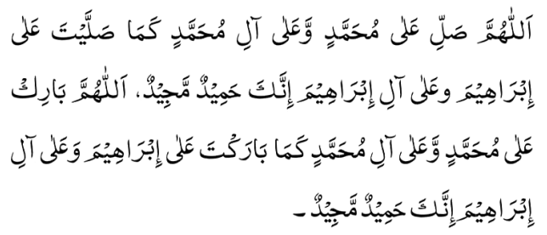
Hadith
O Allah, Bless Muhammad^{sa} and the people of Muhammad^{sa}, as Thou didst bless Abraham and the people of Abraham. Thou art indeed the Praiseworthy, the Glorious. Prosper, O Allah, Muhammad^{sa} and the people of Muhammad^{sa}, as Thou didst prosper Abraham and the people of Abraham. Thou are the Praiseworthy, the Glorious
Anas ibn Malik^{ra} relates that the Holy Prophet^{sa} desired to send a letter to the leaders of foreign nations. Someone said to him that these people do not accept any letter unless it bears a seal (Khatam). Thereupon the Holy Prophet^{sa} had a signet ring (Khatam) made of silver, bearing the words “Muhammad Messenger of Allah.”
Bukhari and Muslim

Slide 6
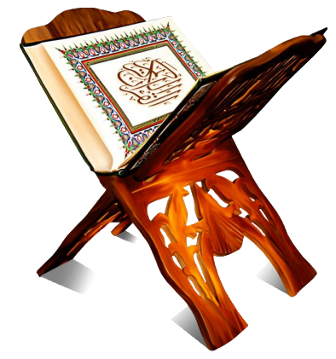
Discussion Segment
Suggested Time 15 mins

Slide 7
Recitation of the Holy Quran
Muhammad is not the father of any of your men, but he is the Messenger of Allah and the Seal of the Prophets; and Allah has full knowledge of all things.
Chapter 33, Verse 41
And whoso obeys Allah and this Messenger of His shall be among those on whom Allah has bestowed His blessings, namely, the Prophets, the Truthful, the Martyrs, and the Righteous. And excellent companions are these.
Chapter 4, Verse 70

Slide 8
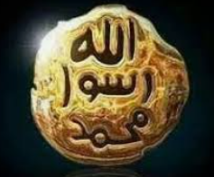
Understanding the verses
Your son joined his Muslim friends in a Muslim students’ club. One day, the president of the club walked up to him and said that the club is only for Muslims. They can’t include him as he has gone against the clear teachings of the Holy Quran in accepting a prophet after the Holy Prophet^{saw}. Your son is disappointed and asked you if that is true and how can he prove from the Holy Quran that the door of prophethood is not shut forever?
What would your answer be?

Slide 9
Understanding the verses
Briefly, according to the meaning of the word خاتم the expression خاتم النبیین can have four possible meanings:
That the Holy Prophet was the Seal of the Prophets, i.e. no Prophet, past or future, can be regarded as true unless his prophethood bears the seal of the Holy Prophet^{sa}. The prophethood of every past Prophet must be confirmed and testified to by the Holy Prophet^{sa} and nobody can attain to prophethood after him except by being his أمتی (follower). All claims to prophethood must be judged and tested by reference to the revelation received by the Holy Prophet^{sa} and to his teachings.
That the Holy Prophet was the best, the noblest and the most perfect of all the Prophets and that he was also a source of embellishment for them (Zurqani, Sharah Mawahibul-Ladunniyya).
That the Holy Prophet was the last of the Law-bearing Prophets. This interpretation has been accepted by many eminent Muslim theologians, saints and savants such as Ibn ‘Arabi, Shah Wali-Allah, Imam ‘AliQari, Mujaddid Alif Thani, etc. According to these great scholars and saints، no Prophet can come after the Holy Prophet who should abrogate his Millah or should not be in his Ummah (Futuhat, Tafhimat, Mukatabat & Yawaqit wal Jawahir). ‘A’ishah, the talented spouse of the Holy Prophet, has removed all ambiguity about the meaning of the expression خاتم النبیین. . She is reported to have said: قولوا انه خاتم النبیین ولا تقولوا لا نبی بعدہ i.e. Say that he (the Holy Prophet^{sa}) is خاتم النبیین but do not say that there will be no Prophet after him (Manthur). This saying of ‘A’ishah^{ra} makes it quite clear that the expression خاتم النبیین and لانبی بعدہ were considered by her to be contradictory to each other in meaning and significance.

Slide 10
Understanding the verses
That the Holy Prophet was the last of the Prophets, but only in this sense that all the qualities and attributes of prophethood found their most perfect and complete consummation and expression in him; خاتم in the sense of being the last word in excellence and perfection is of common use. Moreover, the Quran clearly speaks of the advent of Prophets after the Holy Prophet^{sa}. The following two verses leave no ambiguity on this point: And whoso obeys Allah and this Messenger of His shall be among those on whom Allah has bestowed His blessings, namely, the Prophets, the Truthful, the Martyrs and the Righteous. And excellent companions are these (4:70). This verse shows that by obeying Allah the Almighty and the Holy Prophet (pbuh) one can achieve all spiritual blessings including prophethood. O children of Adam! if Messengers come to you from among yourselves, rehearsing My Signs come unto you, then whoso shall fear God and do good deeds, on them shall come no fear nor shall they grieve (7:36). The Holy Prophet^{sa} himself was clear in his mind as to the continuity of prophethood after him. He is reported to have said:
"If Abraham (his son) had lived long, he would have been a Prophet" (Majah, Kitabul-Janai’z),
and,
"Abu Bakr is best of men after me, except that a Prophet should appear" (Kanzul-‘Ummal).
Five volume commentary

Slide 11
Opinion of non-Ahmadi Scholars
‘Allamah ‘Abdur Rahman bin Khaldun^{rta} (died 808 A.H.) is mentioned as a noted Muslim thinker in the White Paper. He writes:
Saintliness is analogous to prophethood; just as there are various ranks in prophethood, there are similar ranks in sainthood. One who possesses the best of the saintly qualities is called Khatamul-Auliya’, just as the one who possesses the best of the qualities of prophethood is known as Khatamul-Anbiya.’
(alMuqaddimah ibn-e-Khaldun, vol. 1, p. 271)
Hadrat Abu Sa‘id Mubarak Ibn-e-‘Ali Mukharrami^{rta} (died 513 A.H.), the patron saint of no less a person than Hadrat Syed ‘Abdul-Qadir Jilani^{rta}, states:
Man holds the highest position of all creation. When he rises, all the noble qualities in all their grandeur find their manifestation in him and he is called the Perfect Man. The noble qualities in all their grandeur have found their perfection in our Holy Prophet^{sa} and therefore he is Khatamun-Nabiyyin.
(Tuhfa Mursalah Sharif, by Abu Sa‘id Mukharrami, translation and commentary by Muhammad ‘Abdul-‘Aziz Jalandhari, p. 51)

Slide 12
Opinion of non-Ahmadi Scholars
Hadrat Maulana Rum^{rta} (died 672 A.H.) writes:
The Holy Prophet^{sa} is khatam because there neither was nor will be any equal to him in generosity, that is, spreading the blessings…
(Miftahul-‘Ulum, by Maulavi Muhammad Nadhir ‘Arshi)
(Sharah Mathnawi Jalal-ud-Din ar-Rumi^{rta}, vol. 15, Book 6, part 1, p. 56–57)
Maulana Muhammad Qasim Nanotawi, founder of the Deobandi sect, which is now in the forefront of distorting the meaning of Khatamun-Nabiyyin, writes:
Prophets are similar to governors as they are charged with the duty of delivering divine commandments to the people. They are God’s vicegerents. Therefore, it is necessary for them to hold positions of authority. The office of a governor or minister is considered the highest in a chain of subordinate officers. A governor or a minister has the authority to set aside the orders or directives of his subordinates. His orders, on the other hand, cannot be set aside by subordinate officers. The final authority rests with the governor. Similarly, there is no one above the ranks or with more authority than the ‘Khatamun-Nabiyyin.’ All others are subordinate to him.
(Collection of Rare Periodicals and Addresses— Mubahathah Shahjahanpur, 1914, p. 25)

Slide 13
Opinion of non-Ahmadi Scholars
Advent of a Prophet within the Ummah is Not in Conflict with ‘Khatm-e-Nubuwwat’
Now where does their claim go that all past righteous scholars were unanimous in their interpretation and had no doubt about Khatamiyyat having no other meaning than being last in regard to time, and that there can be no other Prophet of any kind. Hadrat Mujaddid Alf-e-Thani who holds a high rank among the Muslims of the Indo-Pak subcontinent, says:
Following the advent of Hadrat Muhammad the Chosen One, the Seal of the Prophet^{sa}, the attainment of the attributes of prophethood by his followers as subordinate or by way of inheritance, will in no way conflict with his status as the Seal of the Prophets. So do not be amongst the doubters.
(Maktubat Imam Rabbani, Book 1, Maktub no. 301, vol. 5, p. 141)

Slide 14
For Further Insight
True Insights into the Concept of Khatm-e-Nubuwwat
A Review of the Pakistani Government’s “White Paper”: Qadiyaniyyat— A Grave Threat to Islam
Replies to Some Allegations
Hadrat Mirza Tahir Ahmad, Khalifatul-Masih IV^{rta}

Slide 15
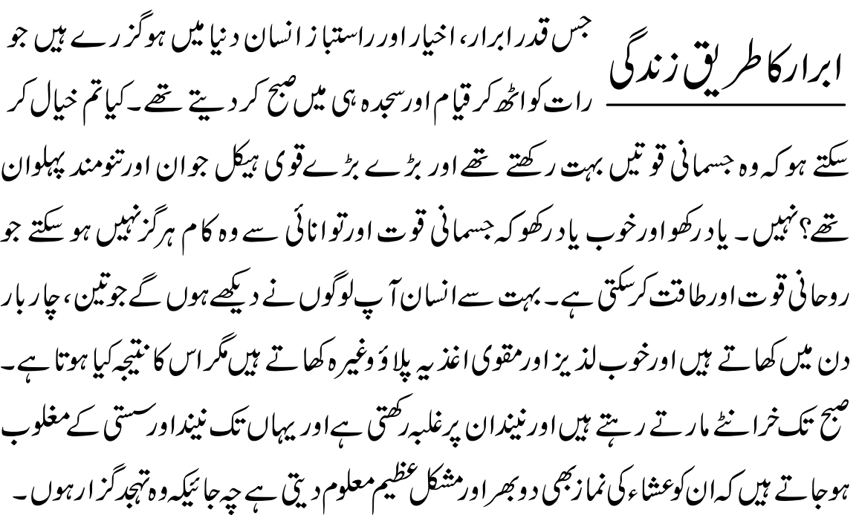
Salat
The Lives of the Pious
The pious, holy and righteous personages who have passed throughout history, spent their nights standing and in prostration until the sun would rise upon them. Do you believe that they possessed extraordinary physical strength? Were they well-built, strong, muscular wrestlers? Not at all. Know well that physical power and strength can never accomplish that which spiritual power and strength can. You must have observed many people who eat three or four times a day and consume many fine and nutritious foods like pilau rice, but what is the outcome? They remain asleep and go on snoring until the sun rises. They become so completely overtaken by sleep and sloth that even to offer the Isha prayer becomes an arduous and incredibly difficult task, let alone Tahajjud.
Malfuzat, Volume 1, P.54

Slide 16
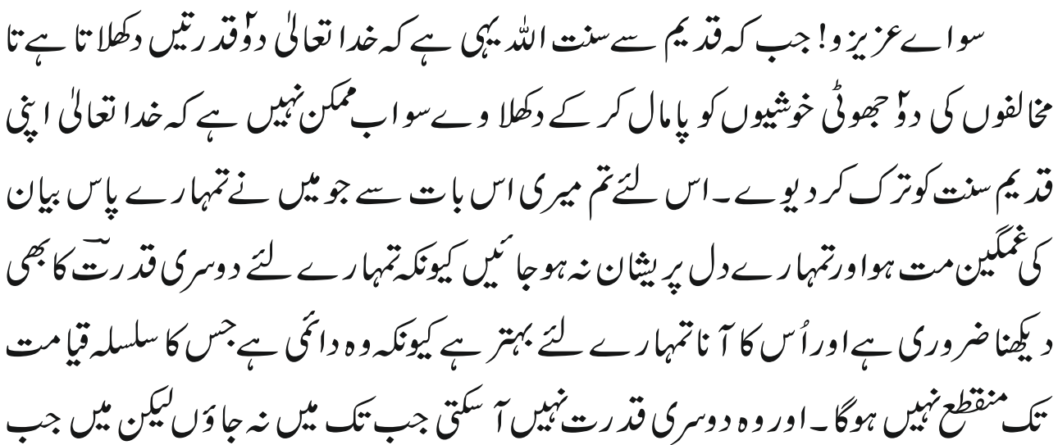
Al Wasiyyat
So dear friends! since it is the Sunnatullah, from time immemorial, that God Almighty shows two Manifestations so that the two false joys of the opponents be put to an end; it is not possible now that God should relinquish His Sunnah of old. So, do not grieve over what I have said to you; nor should your hearts be distressed. For it is essential for you to witness the second Manifestation also, and its Coming is better for you because it is everlasting the continuity of which will not end till the Day of Judgement.

Slide 17
Zahanat
Q. You have two coins equaling 30 cents; one of them is not a quarter. Which coins do you have?
A dime and a nickel
A quarter and a nickel
A quarter and a dime
A dime and a dime
Q. If Mrs. Smith’s rooster lays an egg in Mr. Brown’s yard, who owns the egg?
Mr. Brown
Mrs. Smith
No one
Mr. Smith
Q. There were ten cars in the shop. Customers bought all but nine of them. How many remain in the shop?
8
0
1
9

Slide 18
Zahanat
Q. You have two coins equaling 30 cents; one of them is not a quarter. Which coins do you have?
A dime and a nickel
A quarter and a nickel – The nickel is not a quarter
A quarter and a dime
A dime and a dime
Q. If Mrs. Smith’s rooster lays an egg in Mr. Brown’s yard, who owns the egg?
Mr. Brown
Mrs. Smith
No one – Roosters don’t lay eggs
Mr. Smith
Q. There were ten cars in the shop. Customers bought all but nine of them. How many remain in the shop?
8
0
1
9 – All but 9

Slide 19
Quran Tajweed Basics Ghunnah - Noon Mushadad/Meem Mushadad
Ghunnah means a sustained nasal sound that is emitted from the nose pipe. Meem and Noon are the only two letters which emit this sustained nasal sound when they bear the sign of Shaddah(نّ ,مّ ). This nasalization sound should be two seconds long.
It is the simplest rule to remember, one just need to check, does the noon/meem have a shaddah on top? If so, sound a Ghunnah for two seconds.
Click here for a short video

Slide 20
Health
Avoid Keto Diet
Consume Mediterranean Diet

Slide 21
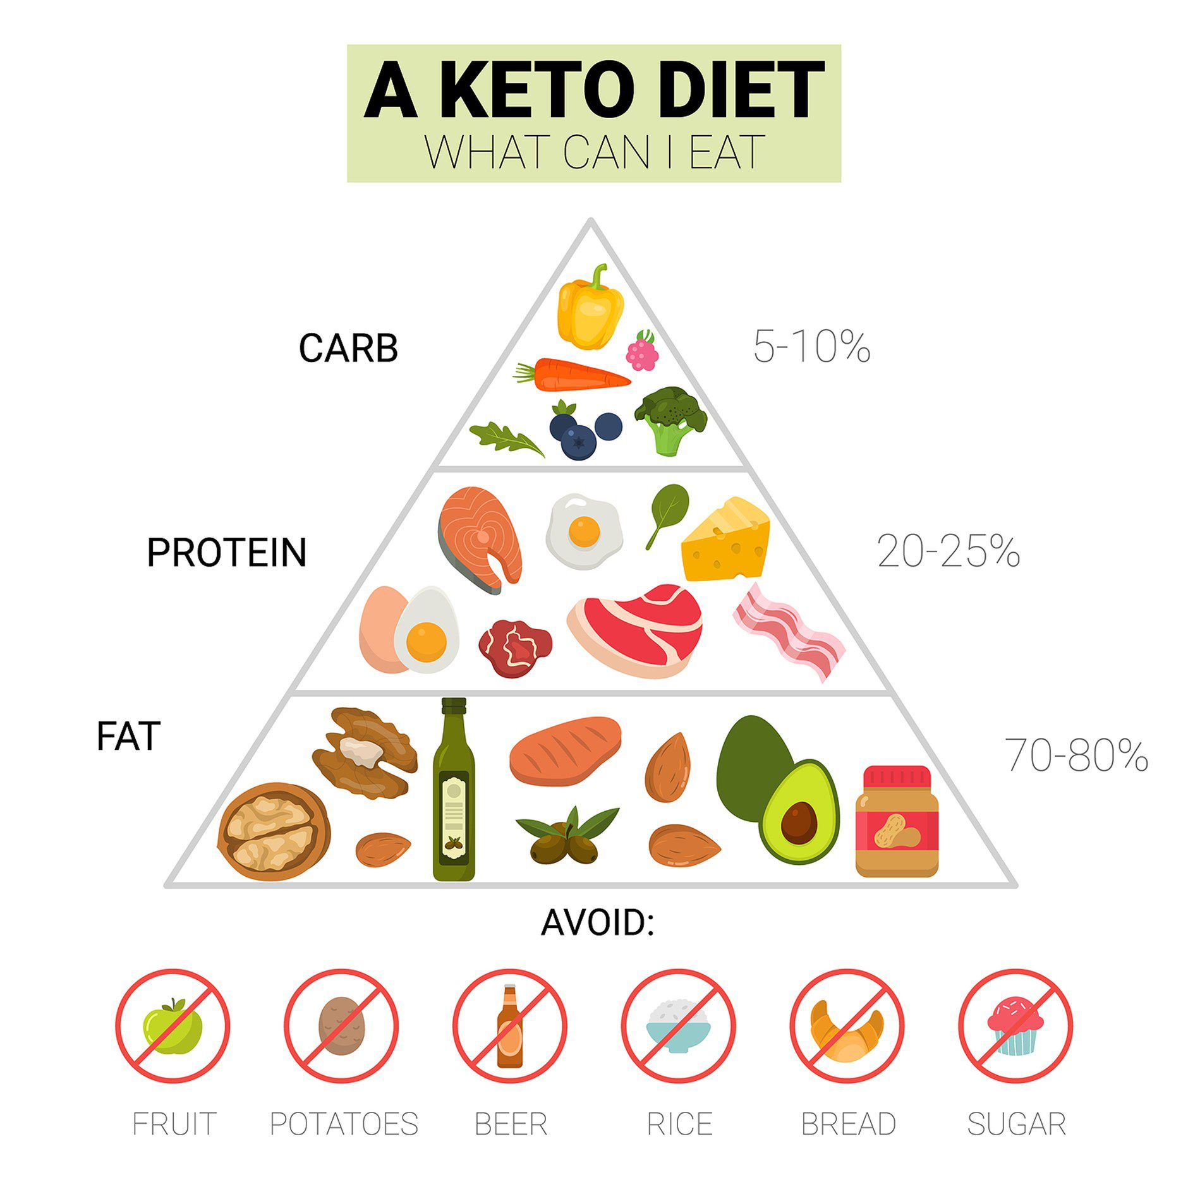
KETO DIET & HEART DISEASE

Slide 22
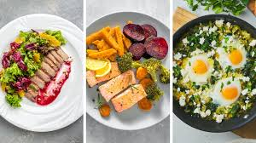
KETO IS A MEDICAL DIET
The keto diet is a medial diet primarily used to help reduce the frequency of epileptic seizures in Children
The ketogenic or Keto diet involves consuming a very low amount of carbohydrates and replacing them with fat; up to 90% calories from fat

Slide 23
heart disease
Keto diet, which bans carbohydrates cuts out healthy food such as fruit, vegetables, beans and legumes, and whole grains
This can increase your risk for Nutritional Deficiencies in micronutrients, including selenium, magnesium, phosphorus, and vitamins B and C.

Slide 24
other adverse effects
of keto diet
Liver problems. High fat burden can worsen existing liver disease
Keto diet can lead to heart problems by raising bad cholesterol
Kidney problems. The kidneys help metabolize protein, and the keto diet may overload and worsen existing kidney disease
The current recommended intake for protein averages 46 grams per day for women, and 56 grams for men

Slide 25
other adverse effects
of keto diet
Constipation. The keto diet is low in fibers found in grains and legumes and frequently results in constipation.
Fuzzy thinking and mood swings The brain needs sugar from healthy carbohydrates to function. Low-carb diets may cause confusion and irritability
These risks add up — so make sure that you talk to a doctor and a registered dietitian before ever attempting a ketogenic diet.

Slide 26
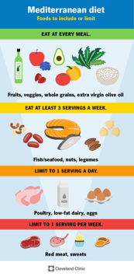
Mediterranean diet
In general, you will eat:
Lots of fruits, vegetables, beans lentils and nuts
Good number of whole grains like whole wheat bread and brown rice
Plenty of extra virgin olive oil
Good amount of fish rich in omega 3 fatty acids
Moderate amount of natural cheese and yogurt
Little or no red meat (replacing it with poultry and fish)
Little or no sugary drinks

Slide 27
Mediterranean diet
The Mediterranean Diet has many benefits, including:
Lowering your risk of cardiovascular disease, including a heart attack or stroke.
Supporting a body weight that’s healthy for you.
Supporting healthy blood sugar levels, blood pressure and cholesterol.
Lowering your risk of metabolic syndrome.
Supporting a healthy balance of gut microbiota (bacteria and other microorganisms) in your digestive system.
Lowering your risk for certain types of cancer.
Slowing the decline of brain function as you age.
Helping you live longer.

Slide 28
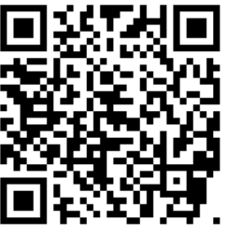
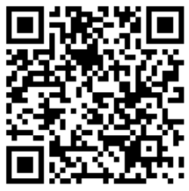
Local Majlis Time
Sign-up for TAQWA Quran classes via the following link https://www.altaqwa.us/registration/
Sign-up for Waqf e Ardhi via the following link https://tinyurl.com/WaqfeArdhiSignup
Murabbi Sahib’s Comments
Reminders/announcements
Du’a
Adjourn
Waqf e Ardhi Sign-up
Jazakumullah for Participating!
If you enjoyed it, please convey to those brothers who are not here today!
Please take a moment to provide your feedback
https://tinyurl.com/TalimDeckFeedback
Feedback

