Slide 1
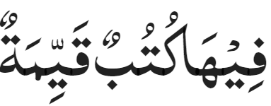
Majlis Ansārullāh
Monthly Meeting
April 2024
Therein are lasting commandments (98-4)
This slide deck contains images licensed for the purpose of this presentation only.
No one is permitted to use the images for any other use, without prior permission.

Slide 2
Agenda
Recitation and translation of the Holy Quran
Pledge
Hadith
Discussion segment
Salat (Daily Prayers)
Al–Wasiyyat
Zahanat
Reading The Holy Quran
Health segment
Local Time – Missionary Comments/Reminders/Announcements
Du’a

Slide 3
Recitation of the Holy Quran
Those who disbelieve from among the People of the Book and the idolaters would not desist from disbelief until there came to them the clear evidence
A Messenger from Allah, reciting unto them the pure Scriptures
Therein are lasting commandments.
Chapter 98 Verse 2-4

Slide 4
Pledge
Say this part three times:
Ash-hadu • alla ilaha • illallahu • wahdahu • la sharika lahu • wa ash-hadu • anna Muhammadan • ‘abduhu • wa rasuluh
Say this part once:
I bear witness • that there is none worthy of worship • except Allah. • He is One • (and) has no partner, • and I bear witness • that Muhammad (peace be upon him) • is His servant • and messenger.
Say this part once:
I solemnly promise that • I shall endeavor • till the end of my life • for the consolidation • and propagation of Islām Ahmadiyyat • and for upholding • the institution of Khilafat. • I shall also be prepared • to offer the greatest sacrifice • for this cause. • Moreover, • I shall urge all my children • to remain true • to Khilafat Ahmadiyya. • Insha’Allah.

Slide 5
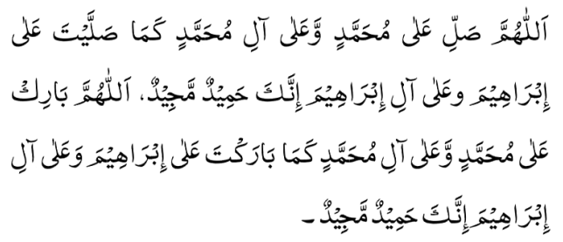
Hadith
O Allah, Bless Muhammad^{sa} and the people of Muhammad^{sa}, as Thou didst bless Abraham and the people of Abraham. Thou art indeed the Praiseworthy, the Glorious. Prosper, O Allah, Muhammad^{sa} and the people of Muhammad^{sa}, as Thou didst prosper Abraham and the people of Abraham. Thou are the Praiseworthy, the Glorious
Hadrat Ali^{ra} relates that the Holy Prophet^{sa}, said:
“A time will come when nothing will remain of Islam except its name, and nothing will remain of the Qur'an except its script. Mosques will be full of worshippers, but as far as righteousness is concerned, they will be empty and deserted. Their 'ulama' (religious scholars) will be the worst of creatures under the canopy of the heavens. Evil plots will originate from them and to them will they return.”
(Mishkat)

Slide 6
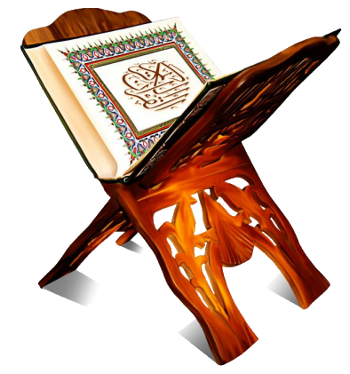
Discussion Segment
Suggested Time 15 mins

Slide 7
Recitation of the Holy Quran
Those who disbelieve from among the People of the Book and the idolaters would not desist from disbelief until there came to them the clear evidence
A Messenger from Allah, reciting unto them the pure Scriptures
Therein are lasting commandments.
Chapter 98 Verse 2-4

Slide 8
Understanding the verses
Majlis Ansarullah arranged a Holy Quran exhibition. Several copies of the Holy Quran with translations in various languages were at display. Many guests visited and were impressed. One of the visitors asked a question of Muntazim tabligh, “Why should I read the Holy Quran? I have my own holy book.”
Why do you think the Quran is better than other books?
Does the Holy Quran claim to be an everlasting and supreme book?
Give some distinguishing features of the Holy Quran
Please quote verses on this topic

Slide 9
Guidance from Promised Messiah^{as}
The Promised Messiah^{as} states:
“The Torah and Gospels do not contain such secrets and intricacies as are replete in the Holy Quran. Furthermore, the Holy Quran doesn’t just mention all the various matters as a mere claim, as is the case in the Torah and Gospels which only make claims, rather, the Holy Quran demonstrates proof and evidence. Everything it mentions is accompanied by strong and robust proof. Just as there is an attraction to the eloquence and articulacy of the Holy Qur’an, and just as its teachings have rationality and an allurement, in the same way, its proofs are effective.”
(Malfuzat [1984], Vol 3, pp. 243-244)

Slide 10
Superiority of the Holy Quran
The source of the Holy Quran is Allah the Almighty Himself as is apparent from the first revealed verses.
The meaning and beauty of the Holy Quran is more apparent on people who are pure and bring about a pious change in them
Whatever claims the Holy Quran makes, it also provides answers and support of those claims. It does not depend on other sources for explanation
The Holy Quran has been arranged in an immaculate sequence
The Holy Quran describes historical stories which have prophecies for times to come
Provides clear proofs of weaknesses in other faiths

Slide 11
Therein are lasting commandments(98-4)
The Holy Quran is a compendium of all that is good, lasting and imperishable in the teachings of former revealed Scriptures, with a good deal more which those Scriptures lack but which man needed for his moral and spiritual development.
All those right ideals and principles and ordinances and commandments which were of permanent utility to man have been incorporated in it.
The Quran stands, as it were, not only as a guardian over those Books but comprises additional teachings that guard and protect man from moral decline and degeneration and teaches him how to make right use of his God given faculties.
Five volume commentary

Slide 12
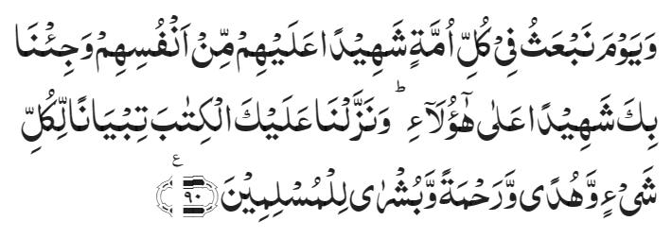
Superiority of Holy Quran
This is a perfect Book; there is no doubt in it; it is a guidance for the righteous
Chapter 2, Verse 3
The Promised Messiah^{as} states:
“It means that, this is the Book that has come into existence out of the knowledge of God Almighty. Since His knowledge is free from ignorance and forgetfulness, this Book is free from every doubt and confusion. And since the knowledge of God possesses the perfect power to make human beings perfect, therefore, this Book is perfect guidance for the righteous. It elevates them to the station that is the highest pinnacle for the progress of human potential.
(Haqiqatul Wahi, pp. 160-161 [English Translation])
And remember the day when We will raise up in every people a witness against them from amongst themselves, and We will bring thee as a witness against these. And We have sent down to thee the Book to explain everything, and a guidance, and a mercy, and glad tidings to those who submit to God.
Chapter 16, Verse 90
The Promised Messiah^{as} writes:
“The Holy Qur’an is a Book which has proclaimed its own matchlessness and has claimed its own greatness, its wisdom, its truth, the beauty of its composition and its spiritual lights.”
(Brahin-e-Ahmadiyya, Ruhani Khaza’in, Vol. 1, pp. 662-665, footnote 11)

Slide 13
Salat
Salat and Inheritance of Heavenly Blessings
Salat is an instrument for security against sins. It is a characteristic feature of Salat that it drives one away from sin and evil deeds. Therefore, seek that sort of Salat and try to mold your Salats accordingly. Salat is the essence of blessings. Favors of Allah are attained through the Salat. Therefore, perform it decently that you may inherit Allah’s blessings.
(Malfuzat Vol. 3 p 103)

Slide 14
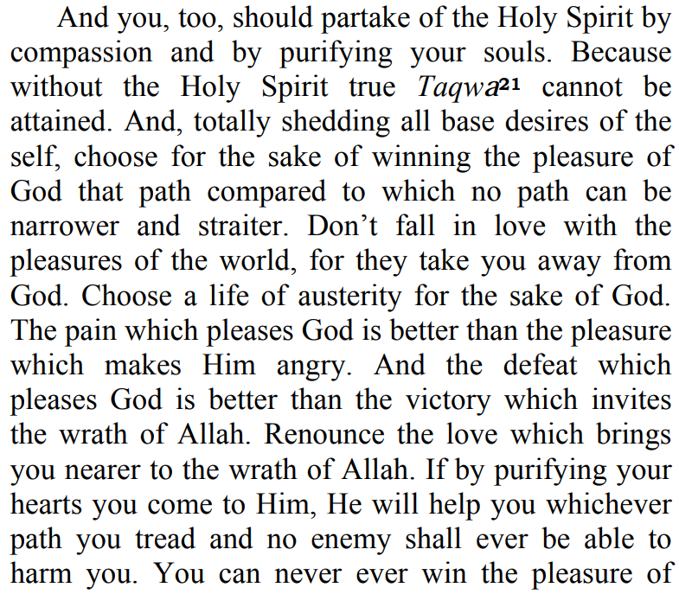
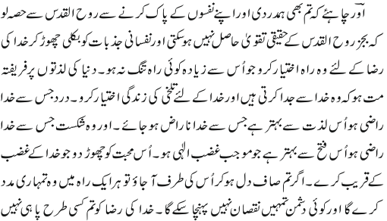
Al Wasiyyat

Slide 15
Zahanat
Q. A red house is made of red bricks, and a blue house is made of blue bricks. What’s a greenhouse made of?
Wood
Fire
Glass
Cement
Q. How much is half of 2 + 2?
4
11
1.5
3
Q. What letter is not included in any of the 50 U.S. state names?
P
Q
Z
X

Slide 16
Zahanat
Q. A red house is made of red bricks, and a blue house is made of blue bricks. What’s a greenhouse made of?
Wood
Fire
Glass
Cement
Q. How much is half of 2 + 2?
4
11
1.5
3
FIRST, you divide 2 by 2, which equals 1.
THEN, you add 2, which gives you 3 as a final answer.
Q. What letter is not included in any of the 50 U.S. state names?
P
Q
Z
X

Slide 17
Long Vowels(Madd-e-Asli)
Quran Tajweed Basics
Long Vowels(Madd-e-Asli)
In Tajweed, Madd refers to lengthening certain vowel sounds. There are three letters of Madd:
Alif(ا)Maddah: if it’s preceded by a letter with Fatha. Ex: رَا(Raa)
Ya’ (ي)Maddah: if it’s preceded by a letter with Kasrah. Ex: مِيٌ (Mee)
Wao(و) Maddah: if it’s preceded by a letter with Dammah. Ex: تُوٌ(Tuu)
Alif (ا) must not have a harkat, Wao(و) and Ya’(ي) must have a sukoon. These are also called Madd-e-Asli and the prolongation should be two harkaat or two seconds.
Click here for a short video

Slide 18
Health

Slide 19
Exercise Program for 40 and over
Tanvir Ahmed

Slide 20
Walking with a Purpose
Brisk Walking for about 30 Minutes a day, five days a week. Walk Fast enough that you cannot SING but can Talk
Power Walking or Speed walking is the act of walking with a speed at the upper end of the natural range for the walking gait, typically 4-5 Miles / Hour. Check out the resources https://fitfortyforever.com/how-to-start-power-walking/

Slide 21
Nordic Walking
Nordic Walking is a total-body version of walking that can be enjoyed both by non-athletes as a health-promoting physical activity, and by athletes as a sport
The activity is performed with specially designed walking poles similar to ski poles
Check out the resources https://www.americannordicwalking.com/blog/2017/3/4/eo4yagte05ql8orxo5vnti12ze0d3n

Slide 22
Swimming
Is a tremendous physical and mental workout
Can be substituted with water aerobics or other water exercises Check out the resources https://www.choosept.com/resources/detail/top-10-exercises-to-do-in-pool

Slide 23
Health Benefits of Cycling
Great outdoor activity for your entire family
You can do it all year around even in very cold and hot weather with proper preparation and technique
Check out the resources https://www.health.harvard.edu/staying-healthy/the-top-5-benefits-of-cycling

Slide 24
Yoga
Great Indoor and Outdoor exercises with minimum investment and equipment
Check out the resources for benefits and how to get started
https://www.nytimes.com/guides/well/beginner-yoga
https://www.healthline.com/nutrition/13-benefits-of-yoga#section5

Slide 25
Is a great physical and mental stress reliever for the entire family
You can garden with a little investment even in a small area
Check the resources http://thenationshealth.aphapublications.org/content/47/5/17
Gardening

Slide 26
Exercise while sitting
Some members who are severely limited by illness or age to exercise.
Others find very difficult to find time to exercise
Here is the link to resources
https://www.nhs.uk/live-well/exercise/strength-and-flexibility-exercises/sitting-exercises/

Slide 27
Local Majlis Time
Sign-up for TAQWA Quran classes via the following link https://www.altaqwa.us/registration/
Murabbi Sahib’s Comments
Reminders/announcements
Du’a
Adjourn
Jazakumullah for Participating!
If you enjoyed it, please convey to those brothers who are not here today!

