Slide 1
Majlis Ansārullāh
Monthly Meeting
March 2024
Does Holy Quran Promote Violence?
This slide deck contains images licensed for the purpose of this presentation only.
No one is permitted to use the images for any other use, without prior permission.

Slide 2
Agenda
Recitation and translation of the Holy Quran
Pledge
Hadith
Discussion segment
Salat (Daily Prayers)
Al–Wasiyyat
Zahanat
Reading The Holy Quran
Health segment
Local Time – Missionary Comments/Reminders/Announcements
Du’a

Slide 3
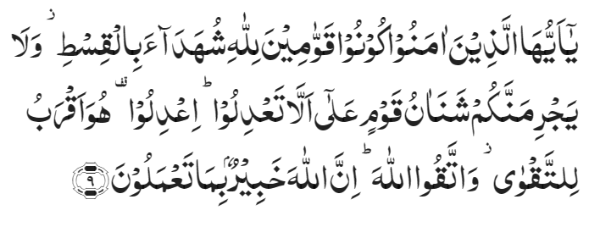
Recitation of the Holy Quran
O ye who believe! be steadfast in the cause of Allah, bearing witness in equity; and let not a people’s enmity incite you to act otherwise than with justice. Be always just, that is nearer to righteousness. And fear Allah. Surely, Allah is aware of what you do.
Chapter 5 Verse 9
Verily, Allah enjoins justice, and the doing of good to others; and giving like kindred; and forbids indecency, and manifest evil, and wrongful transgression. He admonishes you that you may take heed.
Chapter 16 Verse 91

Slide 4
Pledge
Say this part three times:
Ash-hadu • alla ilaha • illallahu • wahdahu • la sharika lahu • wa ash-hadu • anna Muhammadan • ‘abduhu • wa rasuluh
Say this part once:
I bear witness • that there is none worthy of worship • except Allah. • He is One • (and) has no partner, • and I bear witness • that Muhammad (peace be upon him) • is His servant • and messenger.
Say this part once:
I solemnly promise that • I shall endeavor • till the end of my life • for the consolidation • and propagation of Islām Ahmadiyyat • and for upholding • the institution of Khilafat. • I shall also be prepared • to offer the greatest sacrifice • for this cause. • Moreover, • I shall urge all my children • to remain true • to Khilafat Ahmadiyya. • Insha’Allah.

Slide 5
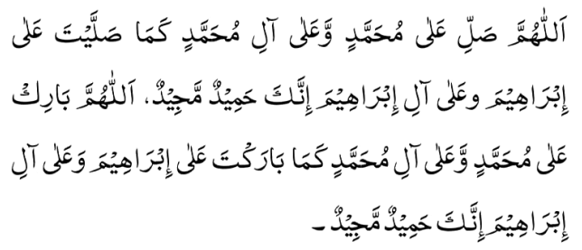
Hadith
O Allah, Bless Muhammad^{sa} and the people of Muhammad^{sa}, as Thou didst bless Abraham and the people of Abraham. Thou art indeed the Praiseworthy, the Glorious. Prosper, O Allah, Muhammad^{sa} and the people of Muhammad^{sa}, as Thou didst prosper Abraham and the people of Abraham. Thou are the Praiseworthy, the Glorious
Hadrat Abdullah bin ‘Amr^{ra}, relates that the Holy Prophet^{sa}, said:
"Surely things will happen to my people as happened earlier to the Israelites. They will resemble each other like one shoe in a pair resembles the other to the extent that if anyone among the Israelites had openly committed adultery with his mother, there will be some who would do this in my ummah (people) as well. Verily, the Israelites were divided into 72 sects, but my people will be divided into 73 sects. All of them will be in the Fire except one.' The Companions asked, 'Who are they, O Messenger of Allah?' The Holy Prophet, peace and blessings of Allah be upon him, said: They are the people who will follow my practice and that of my companions."
(Tirmidhi)

Slide 6
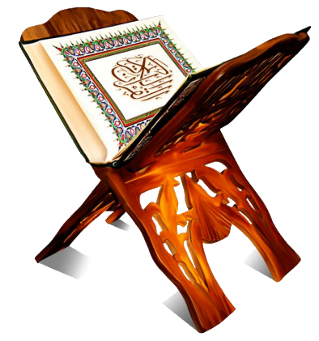
Discussion Segment
Suggested Time 15 mins

Slide 7
Recitation of the Holy Quran
O ye who believe! be steadfast in the cause of Allah, bearing witness in equity; and let not a people’s enmity incite you to act otherwise than with justice. Be always just, that is nearer to righteousness. And fear Allah. Surely, Allah is aware of what you do.
Chapter 5 Verse 9
Verily, Allah enjoins justice, and the doing of good to others; and giving like kindred; and forbids indecency, and manifest evil, and wrongful transgression. He admonishes you that you may take heed.
Chapter 16 Verse 91

Slide 8
Understanding the verses
You are holding a banner of “Muslims for peace” at a flyer distribution event. A church group approaches you with a list of verses. They claim that the Holy Quran teaches to the contrary. It promotes violence against people of different faiths. Present day Muslims want to be politically correct and try to come across as proponents of peace. He quoted this verse “And when the forbidden months have passed, kill the idolaters wherever you find them and take them prisoners, and beleaguer them, and lie in wait for them at every place of ambush. But if they repent and observe Prayer and pay the Zakah, then leave their way free. Surely, Allah is Most Forgiving, Merciful”. Chapter 9 verse 5
How would you explain this and other such verses and counter their argument?
Please quote verses against these arguments

Slide 9
Guidance from Khulafa
The term الاشھر الحرم is generally applied to the four sacred months of Muharram, Dhul-Qa‘dah, Dhul-Hijjah and Rajab, the first three being the months of the Greater Pilgrimage, while in the last the Arabs generally performed the Lesser Pilgrimage or ‘Umrah. In this verse, the words الاشھر الحرم signify not the "sacred months", but "forbidden months“….… These were meant to grant a respite to idolaters to travel through the land in safety and see whether Islam had not triumphed and whether the Word of God had not proved true. At the end of this period, during which all hostilities were to be suspended, war was to be resumed against the idolatrous Arabs with the exception, of course, of such as had entered into a treaty with Muslims, and the treacherous and faithless idolaters already at war with Muslims were to be captured and killed wherever found. It should, however, be remembered that the command to wage war after the expiry of the four forbidden months did not apply to all idolaters without discrimination but was directed only against such avowed enemies of Islam as had themselves started hostilities against Islam and had broken their plighted word and plotted to expel the Holy Prophet from the city…….As for those idolaters who had not been guilty of faithlessness and treachery, they were to be protected (see 9:4 & 7). It is highly regrettable, however, that, divorcing this commandment from its context, some critics have made this verse the basis for an attack against Islam, alleging that it inculcates the destruction of all non-Muslims. The Quran and history belie this baseless allegation.
(Five Volume Commentary Reference 1168)

Slide 10
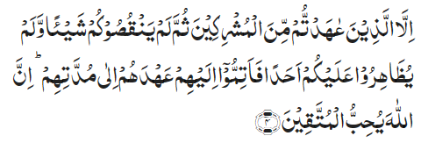
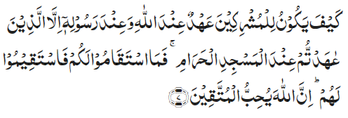
Verses for Protection of the Non-Guilty
Excepting those of the idolaters with whom you have entered into a treaty and who have not subsequently failed you in anything nor aided anyone against you. So, fulfil to these the treaty you have made with them till their term. Surely, Allah loves those who are righteous.
Chapter 9, Verse 4
How can there be a treaty of these idolaters with Allah and His Messenger, except those with whom you entered into a treaty at the Sacred Mosque? So, as long as they stand true to you, stand true to them. Surely, Allah loves those who are righteous.
Chapter 9, Verse 7

Slide 11
The Holy Quran against violence
In chapter 16, verse 91 of the Holy Quran, where Allah the Almighty says:
“Verily, Allah enjoins justice, and the doing of good to others; and giving like kindred…”
Hence, the Quran does not only call upon Muslims to be fair and just, but rather it has established a far higher standard of treating others. Where Allah the Almighty says, “giving like kindred”, He requires a believer to favor others and to always desire the very best for them. It requires Muslims to treat all other people like their close family members. It obliges that they strive to love others, without any desire for reward, just as a mother selflessly loves her child. Furthermore, the Quran does not say that a Muslim should treat only their fellow Muslims in this way, rather it says that they should love ‘others’ and this includes Muslims and non-Muslims alike.
Khutba Juma – Hadrat Khalifatul Masih V^{aba} November 11, 2016

Slide 12
The Holy Quran - Verses against violence
‘Eat and drink of what Allah has provided, and commit not iniquity in the earth, creating disorder.’ (2:61)
‘And they strive to create disorder in the earth, and Allah loves not those who create disorder.’ (5:65)
‘And create not disorder in the earth after it has been set in order…’ (7:57)
‘…create not disorder in the earth after it has been set in order. This is better for you, if you are believers.’ (7:86)
And the servants of the Gracious God are those who walk on the earth in a dignified manner, and when the ignorant address them, they say, ‘Peace!’ (25:64)

Slide 13
Salat
Affirmation of Unity of God
Being inclined to someone other than Allah is to break away from Him. […] Salat is, indeed, the name of practical affirmation of the unity of God.
(Malfuzat Vol. 1 page 107)
Salat and Peace
The greatest criterion of man’s pious life is Salat. He, who keeps crying out to God in Salat, lives in peace.
(Malfuzat Vol. 1 page 402)

Slide 14
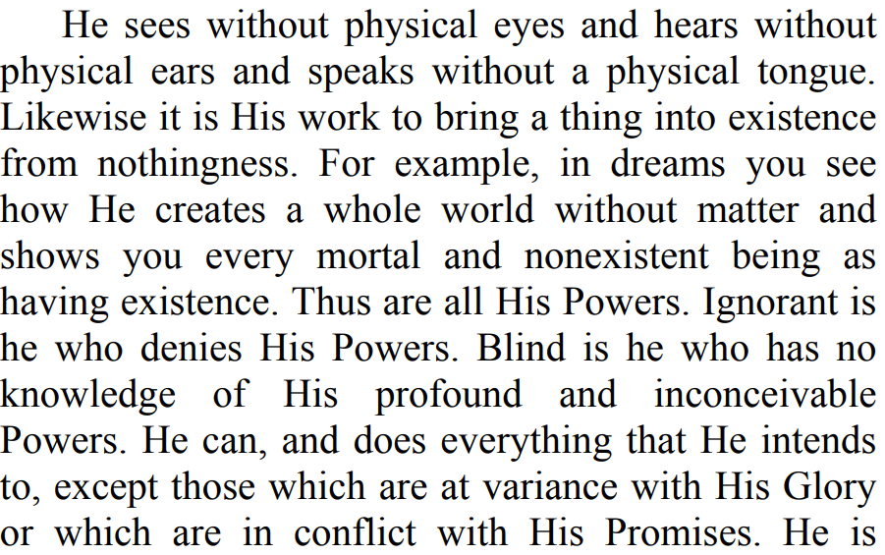
Al Wasiyyat

Slide 15
Zahanat
Q. Who was the first man on to walk on the moon?
Lance Armstrong
Louis Armstrong
Neil Armstrong
Peter Armstrong
None of the above
Q. What do you get when you multiply any number with 0?
0
Infinity
Undefined
- 0
Q. What does I.Q. stand for?
Intellectual Quality
Infinitesimal Quadrant
Inconsistent Quadrilateral
Intelligence Quotient

Slide 16
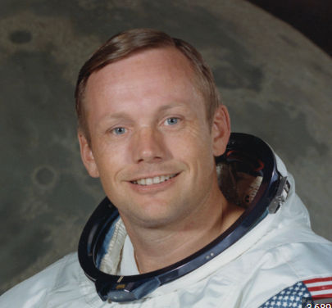
Zahanat
Q. Who was the first man to walk on the moon?
Lance Armstrong
Louis Armstrong
Neil Armstrong
Peter Armstrong
None of the above
Neil Armstrong was a NASA astronaut and aeronautical engineer. He famously became the first person to walk on the moon on July 20, 1969. His phrase, “That's one small step for man, one giant leap for mankind”, has become part of aerospace history.
Q. What do you get when you multiply any number with 0?
Neil Armstrong
0
Infinity
Undefined
- 0
IQ stands for intelligence quotient and, in short, it is a measure of a person's reasoning ability. In other words, an IQ test is supposed to gauge how well someone can use information and logic to answer questions or make predictions.
Q. What does I.Q. stand for?
Intellectual Quality
Infinitesimal Quadrant
Inconsistent Quadrilateral
Intelligence Quotient

Slide 17
Quran Tajweed Basics Short Vowels
There are two types of vowels in Arabic, short and long. One should be very careful in prolonging these vowels. Prolonging and shortening the vowels can change the meaning of the word.
Short vowels: Should be prolonged only for 1 harkat or 1 Sec.
Click here for a short video

Slide 18
Health

Slide 19
High-Fiber Foods
Tanvir Ahmed

Slide 20
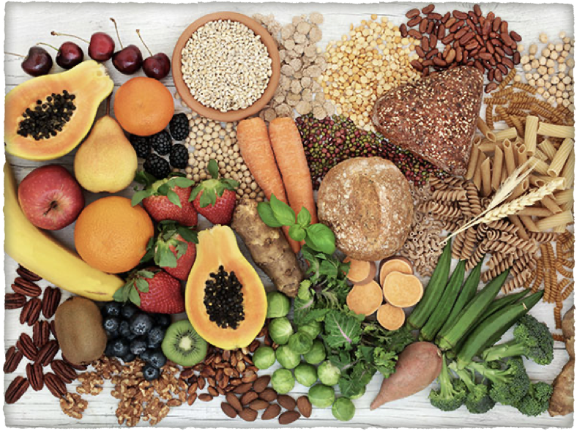
Fiber
Dietary fiber, also known as roughage or bulk, includes the parts of plant foods your body can't digest or absorb.
Dietary Fibers is abundant in plant foods and not digested in our bowel
It aids in keeping our bowels regular and gives us a feeling of fullness
Fibers keeps the bad cholesterol (LDL) low and also helps regulate our sugar
It helps loose weight

Slide 21
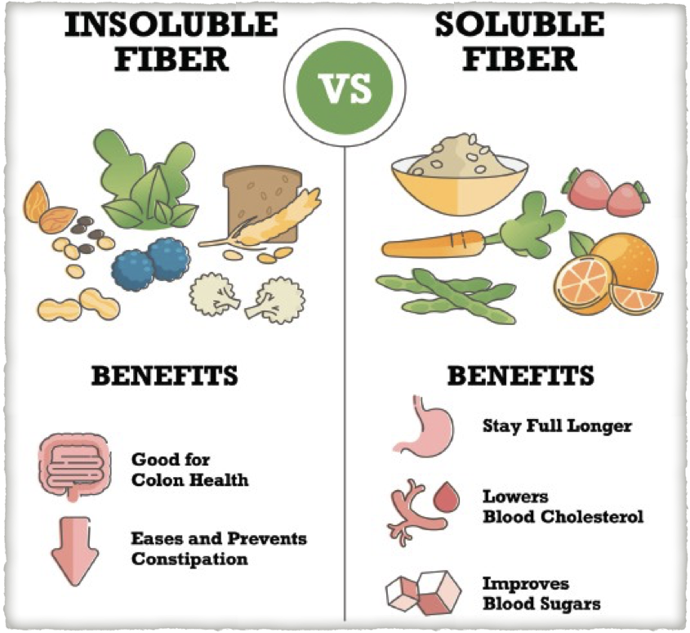
Prevent Heart Disease, Diabetes and Cancer
CDC states that fiber rich diet decreases risk of heart disease, diabetes and some cancers
Increased intake of fruits, vegetables, nuts, seeds, legumes, and whole grain is encouraged
Over 90% of Americans do not consume the recommended amount of fiber (25-34g daily)

Slide 22
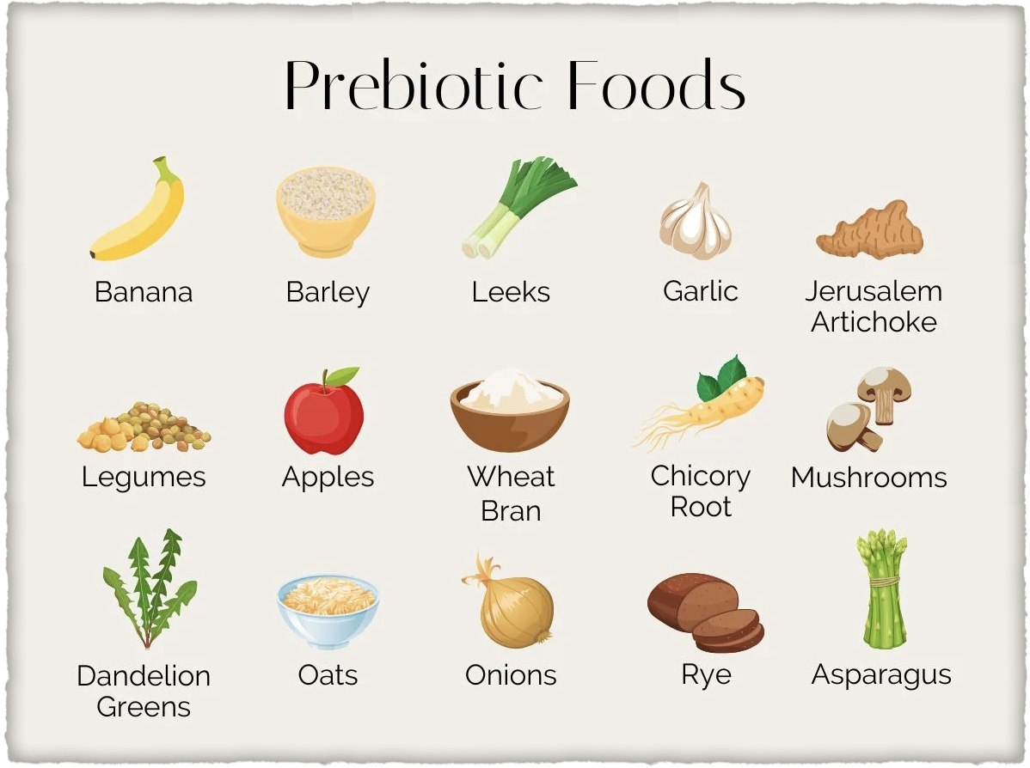
Beneficial Gut Bacteria
A certain type of dietary fiber referred to as Prebiotics, increased good bacteria
Increased gut bacteria and diversity assists in weight loss and reduce obesity

Slide 23
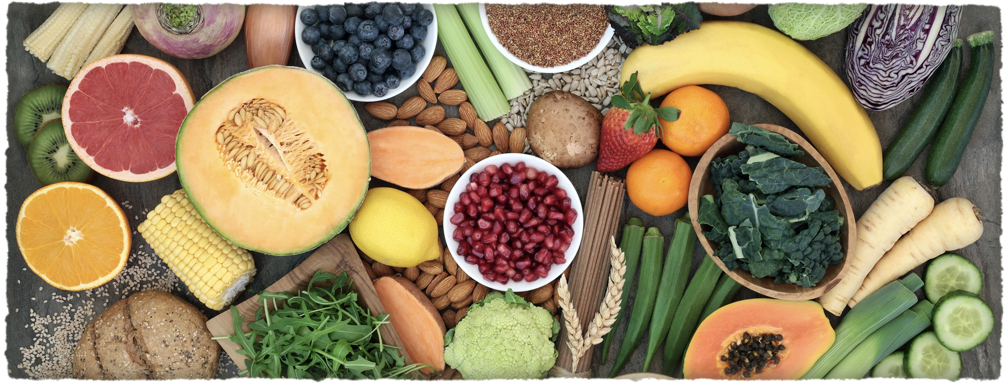
Fibers help your Sugar
Eating more fibers slows glucose absorption in your body
Steady sugars levels are linked to increased satiety
Drink plenty of fluids with fibers to prevent bloating and constipation

Slide 24
Ways to Increase your Fiber Intake
Recommended Fibers for males is 31-34 gas daily
Start your day with a fiber rich breakfast e.g. whole grain bread, low fat yogurt, fruits, nuts, smoothie oats
Here is a link to High Fiber recipes https://insanelygoodrecipes.com/high-fiber-breakfast-recipes/

Slide 25
Ways to Increase your Fiber Intake
Add 1 serving of fruits or vegetables at each meal
1-2 cups of fruits or 2-3 cups of vegetables daily
Eat the skin of fruits and vegetables, apples, pears potatoes
Add one serving of berries
Add one serving of nuts daily
Eat whole grain breads, wheat, oats, brown rice etc. Eat beans, lentils and avocados

Slide 26
Local Majlis Time
Sign-up for TAQWA Quran classes via the following link https://www.altaqwa.us/registration/
Murabbi Sahib’s Comments
Reminders/announcements
Du’a
Adjourn
Jazakumullah for Participating!
If you enjoyed it, please convey to those brothers who are not here today!

