Slide 1
Majlis Ansārullāh Monthly Meeting
September 2023
This slide deck contains images licensed for the purpose of this presentation only.
No one is permitted to use the images for any other use, without prior permission.

Slide 2
Agenda
Recitation of the Holy Quran (5 mins)
Pledge
The Holy Quran segment (10 min)
Khalifa’s guidance segment: (20 min)
Al-Wasiyyat (5 mins)
Salat (Daily Prayers) Segment (5 mins)
Health segment (10 min)
Murabbi sahib’s comments and local topics (10-20 mins)
Reminders/announcements (5 mins)
Du'a
Suggested Total Time (75 – 90 mins)

Slide 3
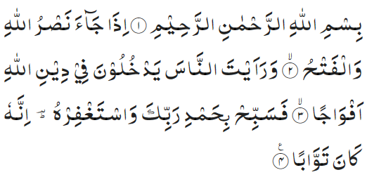
Recitation of the Holy Quran
In the name of Allah, the Gracious, the Merciful. When the help of Allah comes and the victory And thou seest men entering the religion of Allah in troops. Glorify they Lord, with His praise and seek forgiveness of Him. Surely, He is oft returning with compassion (110:1-4)

Slide 4
Ansar Pledge
Say this part three times:
Ash-hadu • alla ilaha • illallahu • wahdahu • la sharika lahu • wa ash-hadu • anna Muhammadan • ‘abduhu • wa rasuluh
Say this part once:
I bear witness • that there is none worthy of worship • except Allah. • He is One • (and) has no partner, • and I bear witness • that Muhammad (peace be upon him) • is His servant • and messenger.
Say this part once:
I solemnly promise that • I shall endeavor • till the end of my life • for the consolidation • and propagation of • Islām Ahmadiyyat • and for upholding • the institution of Khilafat. • I shall also be prepared • to offer the greatest sacrifice • for this cause. • Moreover, • I shall urge all my children • to remain true to • Khilafat Ahmadiyya. • Insha’Allah.

Slide 5
The Holy Quran Segment
Suggested Time = 10 mins
It contains verses, questions
about the verses, followed
by commentary and discussion

Slide 6
Recitation of the Holy Quran
In the name of Allah, the Gracious, the Merciful. When the help of Allah comes and the victory And thou seest men entering the religion of Allah in troops. Glorify they Lord, with His praise and seek forgiveness of Him. Surely, He is oft returning with compassion (110:1-4)

Slide 7
Understanding the Verse
In this chapter, what is Allah the Almighty asking the Holy Prophet (peace and blessings of Allah be upon him) to do?
Why is the Holy Prophet (peace and blessings of Allah be on him) being asked to offer Istighfar?
What is the significance of verse “Surely, He is oft returning with compassion?

Slide 8
Understanding the Verse
The Holy Prophet is here enjoined that since God’s promise has been fulfilled and large masses of people have begun to enter the fold of Islam, he should give thanks to his Lord for fulfilling His promise about victory, sing His praises and seek His protection and forgiveness.
The Holy Prophet (peace and blessings of Allah be upon him) is not being asked to beg forgiveness for his sins as according to the Holy Quran, he enjoyed complete immunity from every moral lapse or deviation from the right course. He is being asked to pray for forgiveness for those who committed crimes against the Holy Prophet as well as the weaknesses and faults of the future Muslim generations.
The expression, "He is Oft-Returning with compassion," holds a message of hope for the Holy Prophet (peace and blessings of Allah be upon him). He is told that whenever there was any danger of his followers deviating from the path of Islam and falling victims to moral decay on a large scale, God will return to them with compassion and will raise from among them a Reformer who will lead them to the right path.

Slide 9
Khalifa’s guidance (may Allah be his helper)
Suggested Time = 20 mins
(All Ansar members need to participate in this discussion)
It contains the following items:
Scenario, question and discussion(2 slides)
Guidance from the Khalifa (1 slide)

Slide 10
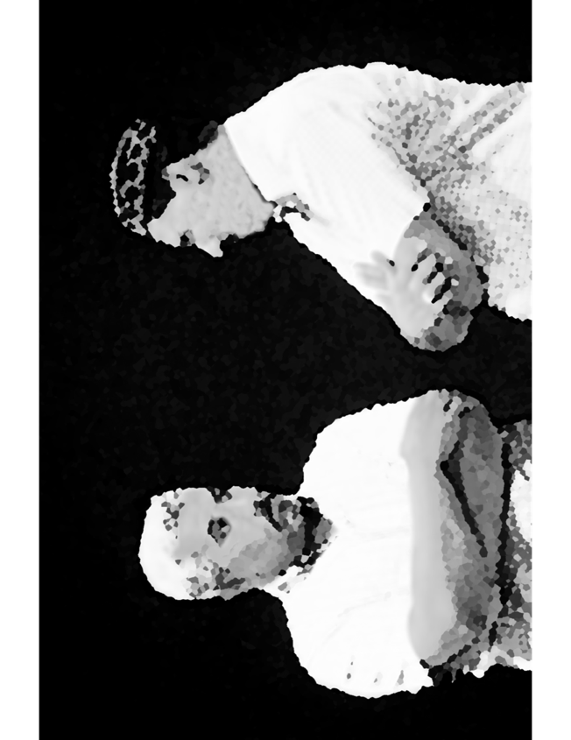
Discussion Scenario
Discussion Scenario
Two Nasirs were discussing about prayers. One Nasir said that the Promised Messiah (peace be on him) has said that “from one point of view, Istighfar has priority over repentance” The other Nasir appeared somewhat confused. He expressed his feeling and stated how can saying Astaghfirullah remove one’s sins?

Slide 11
Discussion
Do you believe offering Istighfar has any benefit?
Does saying Astaghfirullah is an easy remedy to have sins forgiven?
What is the best way to say Istighfar?

Slide 12
Huzur’s words (unofficial translation) Page 1 of 2
“Huzoor (may Allah be his helper) said that along with your domestic guidance, pay attention to Tabligh as well. The newcomers will observe your models and your will have to strive for their training. For this, Allah the Almighty has taught us a lesson to offer Istighfar. If Istighfar is offered with sincerity, reflection and while realizing one’s faults, there will be personal reformation as well as of those who join in the future InshaAllah. There will be reformation of the environment and of the children. There is a lot of power in Istighfar provided it is offered with comprehension. It is offered while keeping those weaknesses and limitations in mind which have been committed by us and while promising not to commit them in the future”. (contd.)

Slide 13
Huzur’s words (unofficial translation) Page 2 of 2
“With this approach in mind, Ansarullah should evaluate themselves, especially the office holders should evaluate themselves and recognize their responsibilities. I expect that most of you will already be acting on this and those who have some weakness and limitations will strive to remove them with new resolve, determination, and assurance. They will try to execute the plans which have been assigned from the Ansarullah auxiliary and the plans which have been assigned from the local Jama’at and the plans which I advise occasionally”. (Refresher course for the office holder of Majlis Ansarullah UK, Al-Fazl 2/22/2008)

Slide 14
Al-Wasiyyat (The Will)
“I pray again: O All-Powerful God of mine, make this piece of land fit for the graves of those of my Jama‘at who are pure of heart and who have in reality become Yours and, in their deeds, there is no adulteration of worldliness, Amin. Again, for the third time do I pray: O my Mighty and Benevolent [God!] O Forgiving and Merciful God, do grant them alone a place for graves here who have true faith in this messenger of Yours and who have no trace of hypocrisy, of selfish motives and of doubt or suspicion in their hearts.” (The Promised Messiah, peace be on him)
Questions for self reflection only (no answer needed in the meeting)
Have you joined the system of Wasiyyat? If not, are you comfortable with your reasoning?
If you are a Moosi, are you satisfied with the spiritual purification expected of you?

Slide 15
Salat Page
The Promised Messiah (peace be on him) said, "Similarly, prayer in the eyes of those who do not offer prayers, is a penalty in that they unjustly have to wake up in the morning, perform ablution in the cold, leave their blissful sleep as well as various other comforts and offer it." The Promised Messiah (peace be on him) said, "The fact of the matter is that he is .. unable to comprehend it. He is unaware of the pleasure and comfort, which is experienced in prayer.” (Friday Sermon 9/29/2017)

Slide 16
Mental and Physical health Segment
Suggested Time = 15 mins
It contains questions of
general knowledge and/or
religious knowledge
followed by their answers.
A thought-provoking video and a physical health segment

Slide 17
Mental Health

Slide 18
Quiz
How much food is wasted in the United states?
Over 100,000 pounds
Over a million pounds
Over a billion pounds
How much height we loose, as we age?
What is schedule C form for Musis?

Slide 19
Answers
c. In the United States, food waste is estimated at between 30-40 percent of the food supply. This estimate, based on estimates from USDA’s Economic Research Service of 31 percent food loss at the retail and consumer levels, corresponded to approximately 133 billion pounds and $161 billion worth of food in 2010.
Height loss is related to aging changes in the bones, muscles, and joints. People typically lose almost one-half inch (about 1 centimeter) every 10 years after age 40. Height loss is even more rapid after age 70. You may lose a total of 1 to 3 inches (2.5 to 7.5 centimeters) in height as you age.
It is binding upon every Musi at the end of each year, in view of his payments in Hissa Amad, to send a testimonial to the Wasiyyat office in accordance with Schedule 'C'. If such testimonial is not received, the case of such a Musi shall be brought before Majlis Karpardaz for consideration.

Slide 20
Working out on the road
Tanvir Ahmed

Slide 21
quick and simple
Workout routine that you can do on the road, regardless of what equipment you have access to.
Quick and simple full bodyweight workout that you can do on the road anywhere.

Slide 22
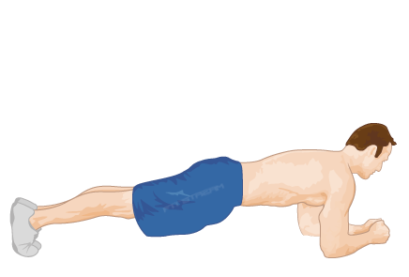
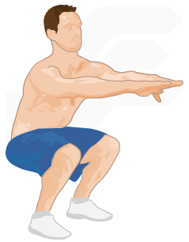
repeat 2-3 Times
Plank Hold x30 seconds-60 seconds
Bodyweight squat x20 repetitions

Slide 23
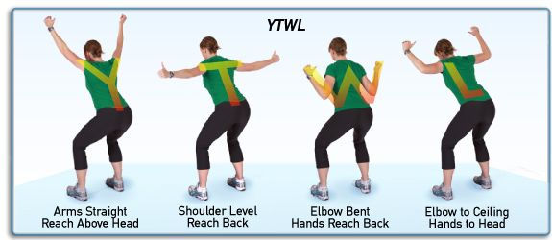
Bent over Y raises x15 repetitions

Slide 24
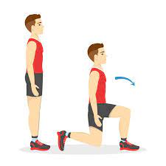
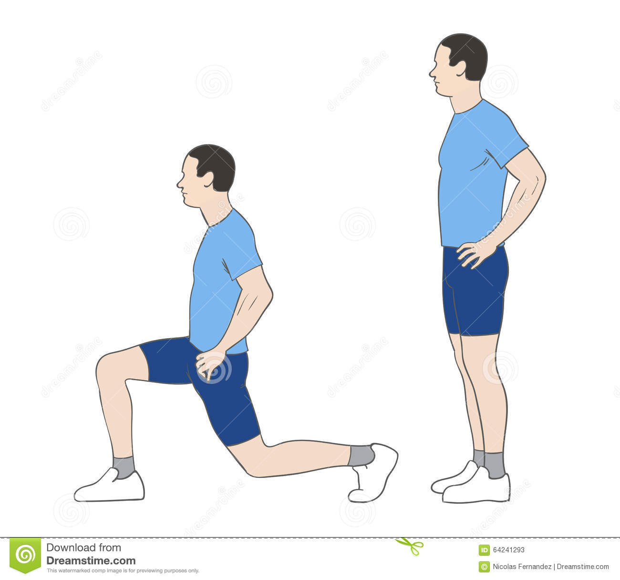
Alternating reverse lunges x10 ea

Slide 25
Bird dog x10 repetitions each side

Slide 26
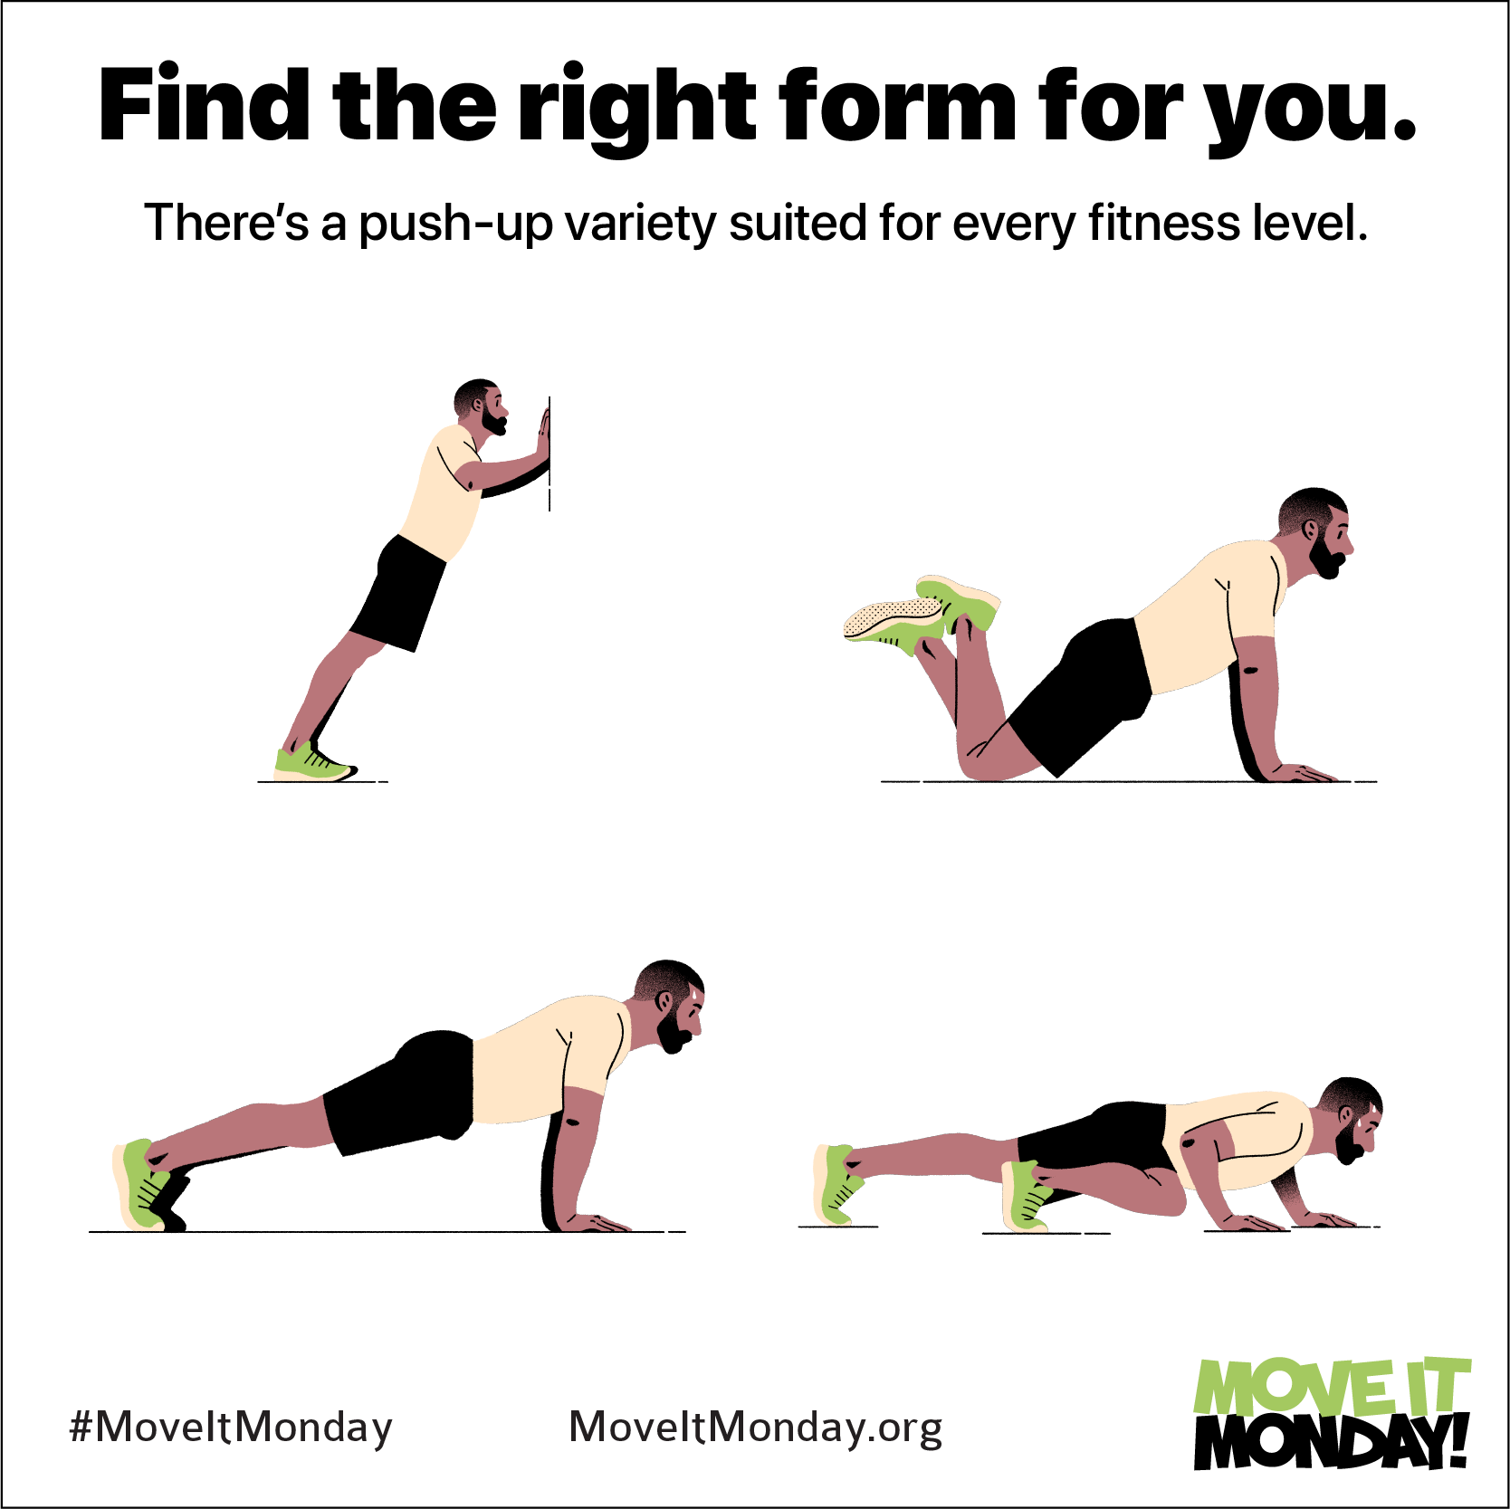
Push-ups x 8-15 repetitions

Slide 27
LOCAL TOPICS

Slide 28
That’s all folks
Reminders/Announcements
Dua
Jazakumullah for Participating!
If you enjoyed it, please convey to those brothers who are not here today!

