Slide 1
Majlis Ansārullāh Monthly Meeting
April 2021
This slide deck contains images licensed for the purpose of this presentation only.
No one is permitted to use the images for any other use, without prior permission.

Slide 2
Agenda
Recitation of the Holy Quran
Pledge
Salat page
The Holy Quran segment (10 min)
- Selected verses
- Questions and commentary
Friday Sermon segment (20 min)
-Sermon synopsis
-Discussion scenario and guidance from sermon
-Take home message
Mental and physical health segment (15 min)
Open slot for local topics
Reminders/announcements
Dua

Slide 3
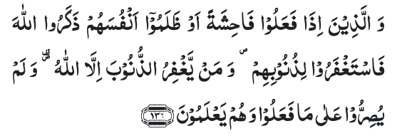
Recitation of the Holy Quran
Those who spend in prosperity and adversity, and those who suppress anger and pardon men; and Allah loves those who do good; (3:135)
And those who, when they commit a foul deed or wrong themselves, remember Allah and implore forgiveness for their sins — and who can forgive sins except Allah? — and do not persist knowingly in what they have done. (3:136)

Slide 4
Ansar Pledge
Say this part three times:
Ash-hadu • alla ilaha • illallahu • wahdahu • la sharika lahu • wa ash-hadu • anna Muhammadan • ‘abduhu • wa rasuluh
Say this part once:
I bear witness • that there is none worthy of worship • except Allah. • He is One • (and) has no partner, • and I bear witness • that Muhammad (peace be upon him) • is His servant • and messenger.
Say this part once:
I solemnly pledge • that I shall endeavor • throughout my life • for the propagation • and consolidation • of Ahmadiyyat in Islam, • and shall stand guard • in defense of • the institution of Khilafat. • I shall not hesitate • to offer any sacrifice • in this regard. • Moreover, • I shall exhort my children • to always remain dedicated • and devoted • to Khilafat. • Insha’allah.

Slide 5
Salat Page
The greatest criterion of man’s pious life is Salat. He, who keeps crying out to God in Salat, lives in peace. (Malfuzat Vol. 1 page 402)
Man can never achieve nearness to Allah without practicing iqamusslat (observance of Salat). He ordered aqeemussalat (observe prayer) because Salat tends to falter and those who comply with iqamussalat they benefit from its spiritual form. […] I have admonished my Jama’at to offer Salat decently and that too is supplication. (Malfuzat Vol. 2p 346)

Slide 6
The Holy Quran Segment
Suggested Time = 10 mins
It contains verses, questions
about the verses followed
by commentary

Slide 7
Recitation of the Holy Quran
Those who spend in prosperity and adversity, and those who suppress anger and pardon men; and Allah loves those who do good; (3:135)
And those who, when they commit a foul deed or wrong themselves, remember Allah and implore forgiveness for their sins — and who can forgive sins except Allah? — and do not persist knowingly in what they have done. (3:136)

Slide 8
Questions
How many stages of dealing with other people are mentioned in the verse 3:135?
Based on the verse 3:136, how can one distinguish a good man committing occasional sin vs a habitual sinner?

Slide 9
Commentary
First stage of restrain and suppression of anger, second stage is of forgiveness and free pardon to the offender, third stage is when along with pardon one also commits suitable act of kindness and bestows favor
Whenever good men happen to commit an error, they do not try to justify their conduct but frankly admit their mistakes and then reform themselves (Five volume commentary)

Slide 10
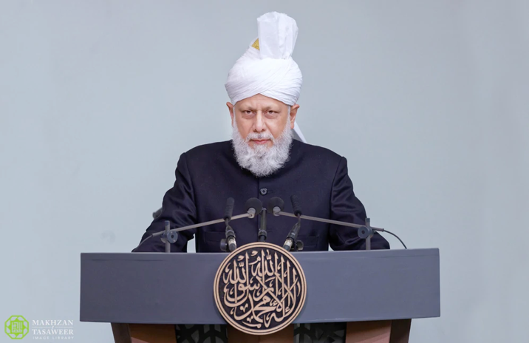
Friday Sermon Segment
Suggested Time = 20 mins
It contains the following items:
Synopsis of Friday Sermon (2 slides)
Scenario discussion and discussion questions (2 slides)
Guidance from Sermon to close the discussion (1 slide)
Take home message from the Sermon (1 slide)

Slide 11
Cause no harm to anyone
Address Jalsa Salana Germany: August 24, 2003
Friday Sermon

Slide 12
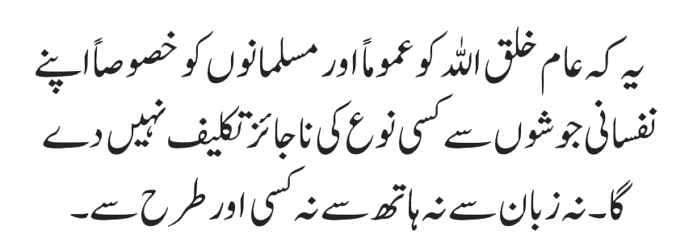
That under the impulse of any passions, he/she shall cause no harm whatsoever to the creatures of God in general and Muslims in particular, neither by his/her tongue, hands, nor any other means.
Fourth condition of Bai’at

Slide 13
Synopsis of the Sermon
Hadhrat Abu Hurairah ^{ra} narrates that the Holy Prophet (pbuh) said: ‘Do not be jealous of one another. Do not quarrel among yourselves. Do not entertain malice against each other. Do not have enmities against one another. None of you should overbid on a contract that has been settled by the other. O servants of Allah, be brothers to one another. A Muslim is a brother to another Muslim. He does not oppress his brother. He does not derogate him nor thinks low of him.’
From the saying of the Holy Prophet (pbuh) that I have presented before, you should focus on the words ‘do not be jealous.’ Jealousy ultimately develops into enmity.
We are directed not to have enmity towards each other. Enmities start from petty matters. Hearts are filled with spite and malice… Then the admonishment is not to oppress anyone, not to think low of anyone, nor to derogate anyone. An oppressor never achieves nearness to Allah…How is it possible that on the one hand one would enter a pledge of allegiance with the one appointed by Allah to win His favor and on the other one would oppress people by snatching their rights.
The clear-cut commandment is that it is not permissible for a Muslim to think poorly of another Muslim under any circumstances.

Slide 14
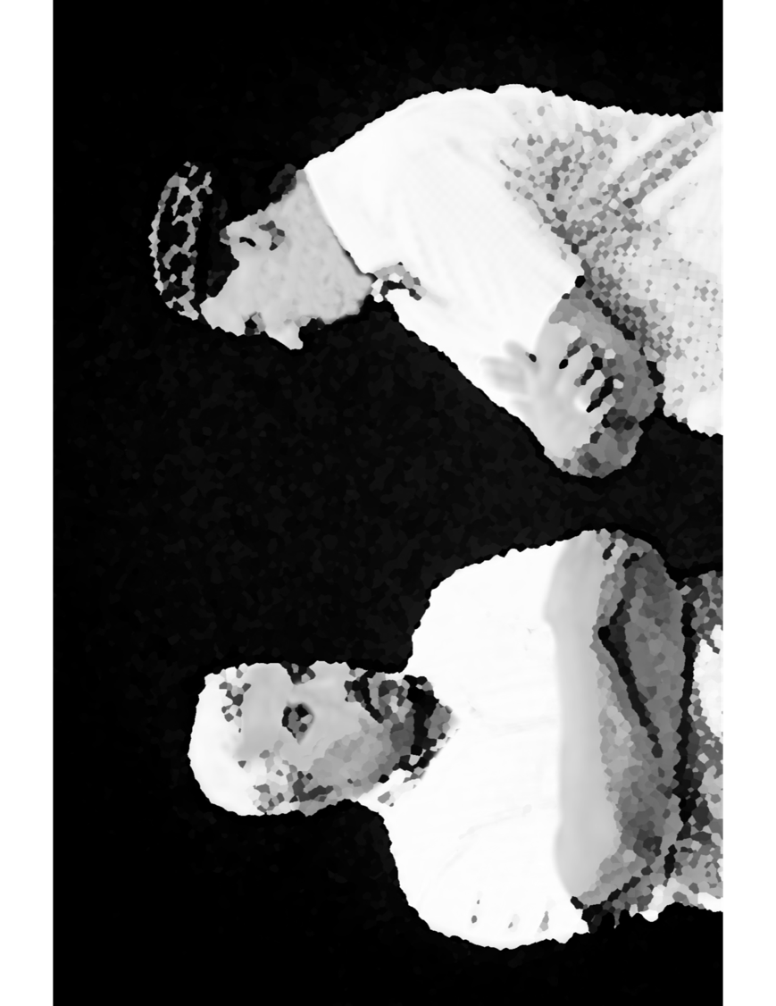
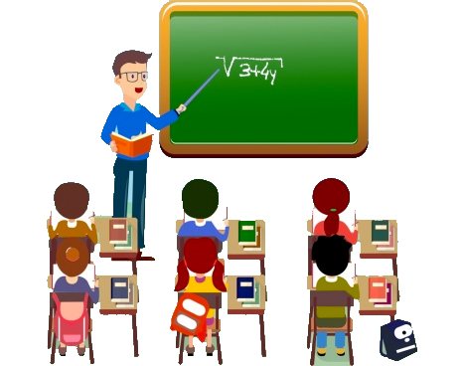
Discussion Scenario
A Nasir brought his 12-year-old son to the Tahir academy class. He sat in the back to observe what goes on in the class. His son was being somewhat disruptive in the class, making it very difficult for the teacher to teach. Ultimately, the teacher called the boy out in front of everyone and told him that he was misbehaving and will have to leave the class to see the principal.
The Nasir got upset and started arguing with the teacher that he had no right to be upset with the boy and embarrass him in front of others.

Slide 15
Discussion
Please share your opinion about following options,
The Nasir should not investigate how the teaching is going on in Tahir academy
The Nasir was justified in defending his child
The teacher should have been more patient with the boy
The Nasir should have kept quiet and approached the principal later

Slide 16
Guidance from the Sermon
Then the Holy Prophet (pbuh) admonishes us not to quarrel with each other. Quarrels take place over petty matters. To give an example, sometimes an officer on duty warns a child who has been mischievous in a gathering that if he were to do it again, he would be dealt with firmly or be corrected. The parents, sitting nearby, immediately roll up their sleeves for a fight, and the person performing the duty is put down in a terrible way. Through this action of theirs, they not only broke a condition of bai‘at and spoiled their good manners, but they also banished from the minds of their next generation the respect for the organization of the Jama 'at and the distinction between good and bad.
Bottom line is that we have to control our anger and try our best not to get in unnecessary arguments and quarrels. The Nasir should have showed patience in this case and advised his child later.

Slide 17
Take "home" message?
Pick one of the following topics from this Friday sermon to discuss with children/family during casual discussion:
Apologize to your family about the times you were unnecessarily angry
Discuss ways to control anger with all members of your family
Tips to engage youth in conversation: (1) Give them more talking time, and (2) use examples from Huzur’s (may Allah be his helper) sermon to make a point.

Slide 18
Mental and Physical health Segment
Suggested Time = 15 mins
It contains questions of
general knowledge and/or
religious knowledge
followed by their answers.
A thought-provoking video and a physical health segment

Slide 19
Mental Health

Slide 20
Quiz
Where in the solar system do scientists believe that it rains diamonds?
Which is the softest known mineral in the world?
When was foundation stone of Minarat-ul-Masih laid?

Slide 21
1. Planets Neptune and Uranus. Due to intense atmospheric pressure, carbon crystallizes into diamonds (americanscientist.org)
2. Talc (geology.com)
3. March 13, 1903
Answers

Slide 22
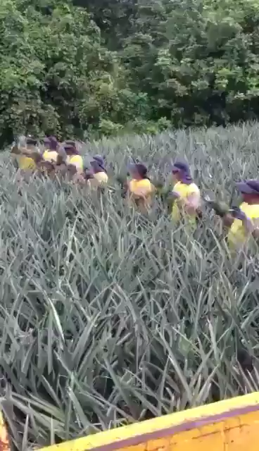
Perspective
We can accomplish a lot if we are united
Pineapple harvesting: From World of Engineering

Slide 23
Physical Health

Slide 24
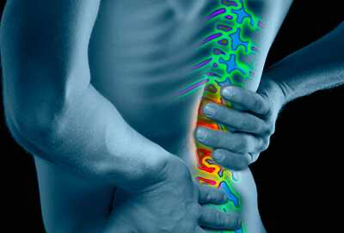
Back pain
TANVIR AHMED
QAID HEALTH

Slide 25
Back pain
One of the most common reasons to see a doctor, miss work, and is the leading cause of disability worldwide
Back pain can be mild muscle spasms to severe and disabling
Pain may shoot down your legs and cause numbness, tingling or weakness
May or may not be related to injury

Slide 26
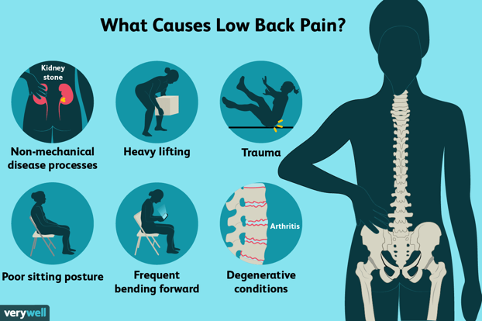
Conditions linked to Back Pain
Muscle or ligament strain. Repeated heavy lifting or a sudden awkward movement can strain back muscles and spinal ligaments. Poor Physical health and constant strain on your back will make matters worse
Bulging or ruptured disks. Disks act as cushions between the bones (vertebrae) in your spine. The soft material inside a disk can bulge or rupture and press on a nerve. However, you can have a bulging or ruptured disk without back pain.
Arthritis of the spine in some cases can lead to a narrowing of the space around the spinal cord, a condition called spinal stenosis.
Osteoporosis. can lead to painful fractures of the vertebrae of your spine especially as we grow old

Slide 27
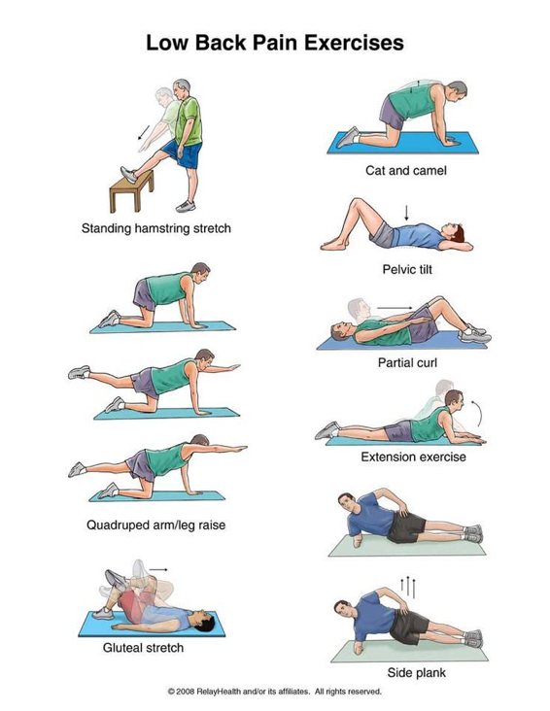
Prevention and Treatment
Exercise. Regular low-impact aerobic activities (walking and swimming) can increase strength and endurance in your back and allow your muscles to function better.
Maintain a healthy weight. Being overweight strains back muscles and may cause pain
Quit smoking. Smoking increases your risk of low back pain
Buyer beware -There's no definitive evidence that special shoes, shoe inserts, back supports, especially designed furniture or stress management programs can help. In addition, there doesn't appear to be one type of mattress that's best for people with back pain

Slide 28
Back pain
Build muscle strength and flexibility. Abdominal & back muscle exercises strengthen your core
Stand smart. Don't slouch. Maintain a neutral pelvic position. When standing for long periods, place one foot on a low footstool to take some load off your lower back. Alternate feet.
Sit smart. Choose a seat with good low-back support, armrests and a swivel base. Placing a pillow/rolled towel in the small of your back can maintain its normal curve. Keep your knees and hips level. Change your position at least every half-hour.
Lift smart. Avoid heavy lifting but when you must do it, let your legs do the work. Keep your back straight, no twisting, and bend only at the knees. Hold the load close to your body. Find a lifting partner whenever possible
Alternative Modalities - Chiropractor, Yoga, Massage, Acupuncture etc.

Slide 29
Open Segment
Suggested Time = Zaim’s discretion
Zaim can include any other segment of local interest in this segment

Slide 30
That’s all folks
Reminders/Announcements
Dua
Jazakumullah for Participating!
If you enjoyed it, please convey to those brothers who are not here today!

