Slide 1
Majlis Ansārullāh Monthly Meeting
January 2021
This slide deck contains images licensed for the purpose of this presentation only.
No one is permitted to use the images for any other use, without prior permission.

Slide 2
Agenda
Recitation of the Holy Quran
Pledge
Salat page
The Holy Quran segment (10 min)
- Selected verses
- Questions and commentary
Friday Sermon segment (20 min)
-Sermon synopsis
-Discussion scenario and guidance from sermon
-Take home message
Mental and physical health segment (15 min)
Open slot for local topics
Reminders/announcements
Dua

Slide 3
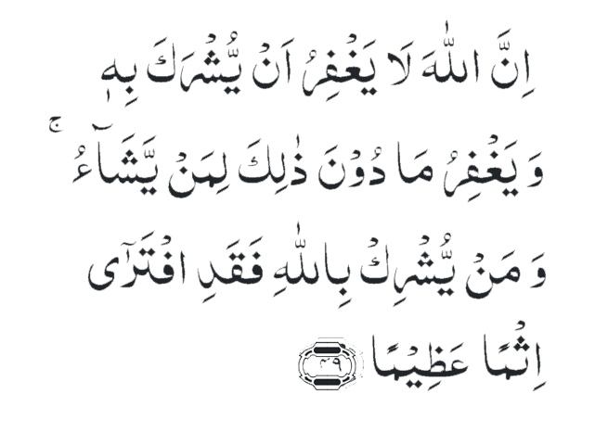
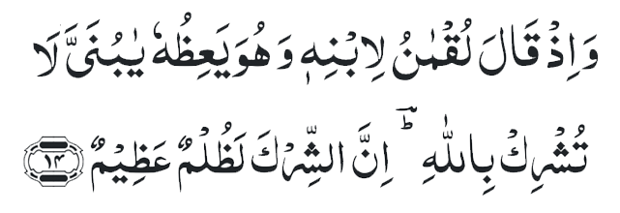
Recitation of Holy Quran
Recitation of Holy Quran
Surely, Allah will not forgive that any partner be associated with Him; but He will forgive whatever is short of that to whomsoever He pleases. And whoso associates partners with Allah has indeed devised a very great sin. (4:49)
And remember when Luqman said to his son while exhorting him, ‘O my dear son! associate not partners with Allah. Surely, associating partners with God is a grievous wrong.’ (31:14)

Slide 4
Ansar Pledge
Say this part three times:
Ash-hadu • alla ilaha • illallahu • wahdahu • la sharika lahu • wa ash-hadu • anna Muhammadan • ‘abduhu • wa rasuluh
Say this part once:
I bear witness • that there is none worthy of worship • except Allah. • He is One • (and) has no partner, • and I bear witness • that Muhammad (peace be upon him) • is His servant • and messenger.
Say this part once:
I solemnly pledge • that I shall endeavor • throughout my life • for the propagation • and consolidation • of Ahmadiyyat in Islam, • and shall stand guard • in defense of • the institution of Khilafat. • I shall not hesitate • to offer any sacrifice • in this regard. • Moreover, • I shall exhort my children • to always remain dedicated • and devoted • to Khilafat. • Insha’allah.

Slide 5
Salat Page
“I tell you again that if you wish to establish a true relationship with God, hold fast to Salat in such a way that your body and your tongue and your spiritual designs and emotions should all become Salat”
(Promised Messiah, Malfuzat, Vol. I, p. 170).

Slide 6
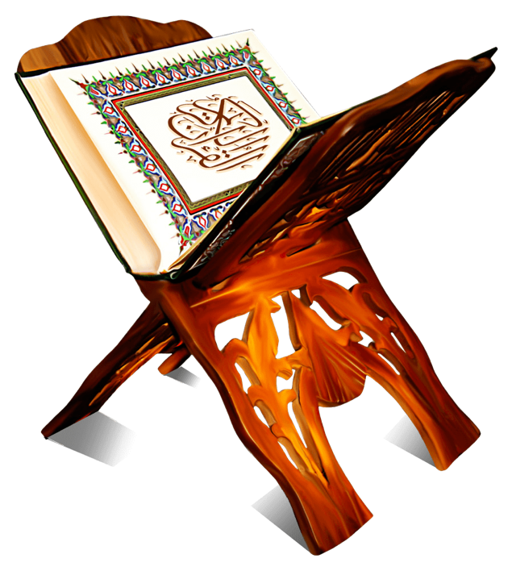
The Holy Quran Segment
Suggested Time = 10 mins
It contains verses, questions
about the verses, followed
by commentary

Slide 7
Recitation of the Holy Quran
Surely, Allah will not forgive that any partner be associated with Him; but He will forgive whatever is short of that to whomsoever He pleases. And whoso associates partners with Allah has indeed devised a very great sin. (4:49)
اِنَّ اللّٰہَ لَا یَغۡفِرُ اَنۡ یُّشۡرَکَ بِہٖ وَ یَغۡفِرُ مَا دُوۡنَ ذٰلِکَ لِمَنۡ یَّشَآءُ ۚ وَ مَنۡ یُّشۡرِکۡ بِاللّٰہِ فَقَدِ افۡتَرٰۤی اِثۡمًا عَظِیۡمًا ﴿۴۹﴾
And remember when Luqman said to his son while exhorting him, ‘O my dear son! associate not partners with Allah. Surely, associating partners with God is a grievous wrong.’ (31:14)
وَ اِذۡ قَالَ لُقۡمٰنُ لِابۡنِہٖ وَ ہُوَ یَعِظُہٗ یٰبُنَیَّ لَا تُشۡرِکۡ بِاللّٰہِ ؕؔ اِنَّ الشِّرۡکَ لَظُلۡمٌ عَظِیۡمٌ ﴿۱۴﴾

Slide 8
Questions
If Allah does not forgive shirk, what happens if idolatrous person becomes a Muslim?
What is “hidden shirk” and would it not be forgiven as well?

Slide 9
Commentary
The expression, “Allah will not forgive”, does not mean that an idolatrous person can never repent or that his repentance can’t be accepted even in the present life. The expression relate to the time after death i.e., one who dies in a state of shirk will not be forgiven.
Hidden shirk such as loving or trusting in a thing or being as one should love and trust in God, may be forgiven, if done in ignorance and through lack or proper care, provided one is a sincere believer in God and His Prophet and strives to do good works. (Five volume commentary)

Slide 10
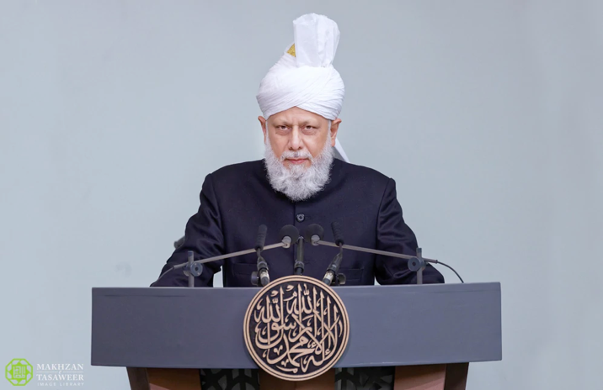
Friday Sermon Segment
Suggested Time = 20 mins
It contains the following items:
Synopsis of Friday Sermon (2 slides)
Scenario discussion and discussion questions (2 slides)
Guidance from Sermon to close the discussion (1 slide)
Take home message from the Sermon (1 slide)

Slide 11
Associating partners with Allah Concluding address Jalsa Salana UK: July 27, 2003
Friday Sermon

Slide 12
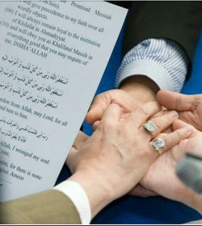
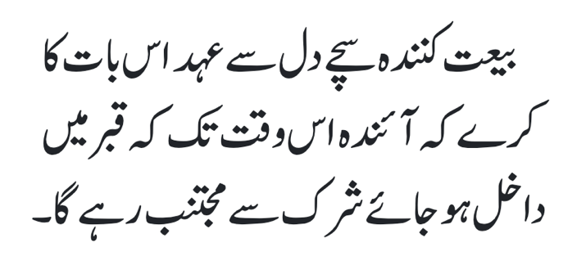
The initiate shall solemnly promise that he/she shall abstain from shirk [associating any partner with God] right up to the day of his/her death.
First condition of Bai’at

Slide 13
Synopsis of the Sermon
Shirk here does not merely mean bowing before stones, etc.; rather, it is also shirk that you should depend entirely on worldly means and emphasize worldly idols. This is what shirk is.
Resorting to ostentation and following one’s desires are also forms of shirk.
To associate anyone in the name, action, or worship of Allah constitutes shirk, and to carry out all good deeds solely for the pleasure of Allah is called worship.
No Unity can be complete without the following three types of particularizations. First, there is the Unity of Being—that is, to conceive the whole universe as nonexistent in contrast with Him and to consider it mortal and lacking reality. Secondly, the Unity of Attributes—that is that Rabubiyyat [Lordship] and Uluhiyyat [Godhead] are confined to His Being and that all others who appear as sustainers or benefactors are only a part of the system set up by His hand. Thirdly, the Unity of love, sincerity and devotion—that is, not to consider anyone as an associate of God in the matter of love and worship and to be entirely lost in Him.

Slide 14
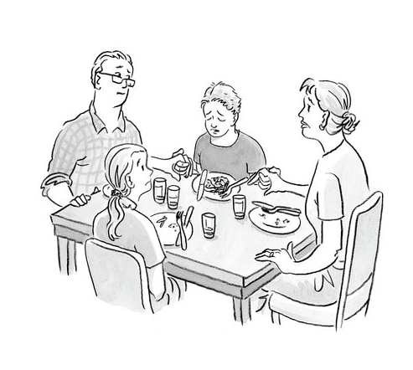
Discussion Scenario
A Nasir’s son comes home from school sick. The Nasir was very concerned and got upset at his wife. He tells her that he is sure that the soup she made last night caused the illness. He tells his son to make sure that he drinks plenty of fluids and gets some rest. The Nasir advises him to go to the doctor in the morning. He gives him a hug and tells him that “if you act smart and use common sense you don’t get sick”.

Slide 15
Discussion
Was the Nasir’s approach appropriate?
Was he justified in blaming the soup?
Was there anything wrong with Nasir’s message to his son?
How would you have handled the situation?

Slide 16
Guidance from the Sermon
The Promised Messiah (as) says:
Tauhid [Unity of God] does not simply mean that you say lailaha illAllah with
your tongue but then hide hundreds of idols in your heart. Anyone who gives
reverence to his own plans, mischief or clever designs as he should revere
God, or depends upon another person as one should depend upon God alone or reveres his own ego as he should revere God alone, in all such conditions he is an idol-worshipper in the sight of Allah. Idols are not merely those that are made of gold, silver, copper or stones. Rather, everything, every statement, or every deed, which is revered in a manner that befits Almighty Allah alone, is an idol in the sight of Allah....
(Siraj-ud-Din ‘Isa’i ke Char Swalon ka Jawab, Ruhani Khaza’in, vol. 12, pp. 349–350)
In our opinion, we must, always, remember Allah the Almighty. We are encouraged to use resources but rely primarily on Allah. In this scenario, the father was not able to teach his son properly about trust in Allah the Almighty

Slide 17
Take "home" message?
Pick one of the following topics from this Friday sermon to discuss with children/family during casual discussion:
What is shirk?
What are different types of shirk and evaluate if you or your family may be inadvertently involved in them?
How would you and your family eliminate any type of shirk?
Tips to engage youth in conversation: (1) Give them more talking time, and (2) use examples from Huzur’s (may Allah be his helper) sermon to make a point.

Slide 18
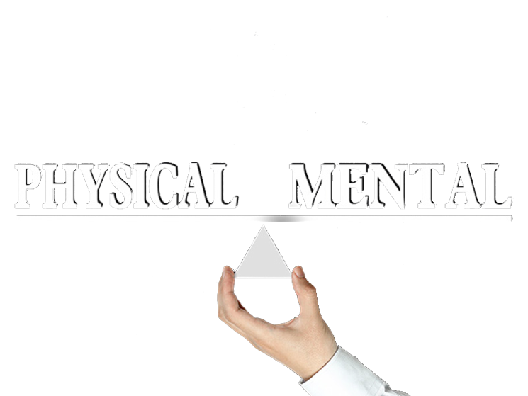
Mental and Physical health Segment
Suggested Time = 15 mins
It contains questions of
general knowledge and/or
religious knowledge
followed by their answers.
A thought-provoking video and a physical health segment

Slide 19
Mental Health

Slide 20
Quiz
What is the coldest place in the world?
Which is the naturally occurring heaviest element in the world?
When did Mirza Ghulam Ahmad of Qadian claim to be a Mujaddid (reformer)?

Slide 21
1. It is a high ridge in Antarctica on the East Antarctic Plateau where temperatures in several hollows can dip below minus 133.6 degrees Fahrenheit (minus 92 degrees Celsius) on a clear winter night. (nasa.gov) 2. Uranium (nature.com)
3. March 1885
Answers

Slide 22
Perspective
This interesting sculpture called Squaring the Circle was created in 2013 by Troika. Watch the video below to see how these CNC bent steel tubes (measuring 54 3/4 x 54 3/4 x 30 1/2 inches) form a square when viewed from one angle and a circle when viewed from another.
This shows how our perception and angle of view can deceive us. It is important to consider all aspects before making an interpretation.
Perspective: From Wonders of Science

Slide 23
Physical Health

Slide 24
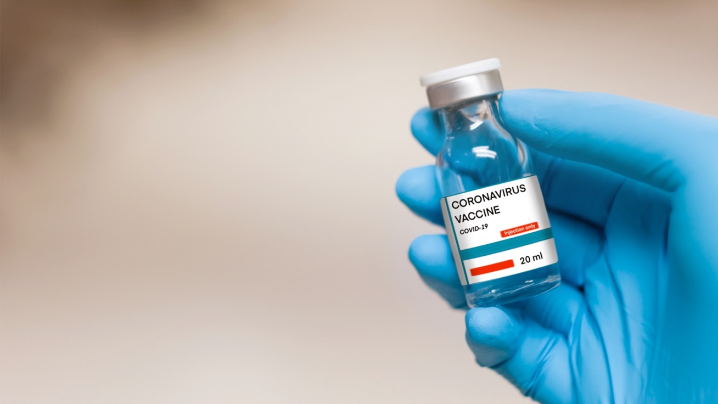
RNA Coronavirus VACCINE
Made of a portion of the structure of the virus (RNA)
When injected, this portion leads to formation of a part of the virus structure. Body mounts an immune response to this structure.
This immunity helps to fight off the virus in the future.
It protects us from getting Coronavirus disease in the future (95% effective)
It helps end the pandemic and save the population
It can not cause Coronavirus disease
Please do not rely on information from unverified sources, read cdc.gov for up-to-date information

Slide 25
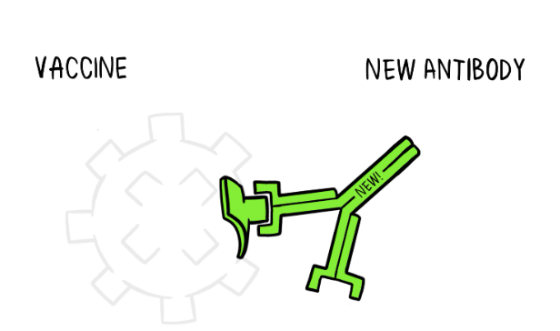
Coronavirus VACCINE (cdc.gov)
COVID vaccine has been tested in thousands of individuals and so far, has been found to be safe
It has been recommended that people 16 yr. and older be vaccinated (Over 18 for Moderna vaccine)
COVID vaccine can not cause COVID
It increases our internal immunity towards Coronavirus
A Vaccine is a tiny weakened non-dangerous fragment of the organism and includes part of the antigen. It’s enough that our body can learn to build the specific antibody. Then if the body encounters the real antigen after, as part of the real organism it already knows how to defeat it
We need two doses 3-4 weeks apart for maximum benefit
Minor reactions are expected. More so after the second dose. These include local reactions such as redness, pain and swelling and generalized reactions such as malaise, fatigue, headache and fever. These reactions will subside in 2-3 days

Slide 26
Open Segment
Suggested Time = Zaim’s discretion
Zaim can include any other segment of local interest in this segment

Slide 27
That’s all folks
Reminders/Announcements
Dua
Jazakumullah for Participating!
If you enjoyed it, please convey to those brothers who are not here today!

