Slide 1
Majlis Ansarullah Monthly Meeting
October, 2020
This slide deck contains images licensed for the purpose of this presentation only. No one is permitted to use the images for any other use, without prior permission.

Slide 2
AGENDA
Recitation of the Holy Quran (16:126)
Pledge
Sermon of the month: Khalifatul Masih II - Pearls of Wisdom (related to Tabligh) (3/13/2015)
Verse from the Holy Quran
Advice from the sermon
Discussion scenario
Did you know?
Salat page
Health Tip
Free time slot for local topics
Reminders/announcements
Dua

Slide 3
Recitation of the Holy Quran
Call unto the way of thy Lord with wisdom and goodly exhortation, and argue with them in a way that is best. Surely, thy Lord knows best who has strayed from His way; and He knows those who are rightly guided (16:126).

Slide 4
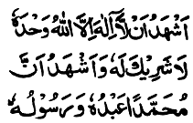
Ansar Pledge
Say this part three times:
Ash-hadu • alla ilaha • illallahu • wahdahu • la sharika lahu • wa ash-hadu • anna Muhammadan • ‘abduhu • wa rasuluh
Say this part once:
I bear witness • that there is none worthy of worship • except Allah. • He is One • (and) has no partner, • and I bear witness • that Muhammad (peace be upon him) • is His servant • and messenger.
Say this part once:
I solemnly pledge • that I shall endeavor • throughout my life • for the propagation • and consolidation • of Ahmadiyyat in Islam, • and shall stand guard • in defense of • the institution of Khilafat. • I shall not hesitate • to offer any sacrifice • in this regard. • Moreover, • I shall exhort my children • to always remain dedicated • and devoted • to Khilafat. • Insha’allah.

Slide 5
Khalifatul Masih II - Pearls of Wisdom (related to Tabligh)
Friday Sermon, March 13, 2015
Friday Sermon

Slide 6
Discussion on verse
What is the meaning of “Hikma” or wisdom?
Based on this verse what are the requisites of doing Tabligh?

Slide 7
Commentary
Various meaning of the word “Hikma” or wisdom include
Knowledge, Equity and justice, Forbearance, Firmness, Any saying in accordance with truth, Gift of prophecy, and What prevents ignorant behavior
In doing tabling all of these meanings of wisdom have to be kept in mind. Along with that the arguments should appeal the sentiments. We should keep in mind the occasion and should not wound other people’s susceptibilities. However, should not shy away in mentioning the truth with strongest arguments. (Five volume commentary)

Slide 8
1. The Promised Messiah (peace be on him) would think of unique ways of doing Tablīgh. He would spend his days and nights reflecting upon the best possible ways of communicating the message of Islām to every corner of the world. 2. The wish of the Promised Messiah (peace be on him) have been for Ahmadīs to attract the attention of the people on the one hand, and on the other to be personally mindful of their practices and the condition of their faith as they were to present themselves before the world as Ahmadīs. 3. The purpose of the Promised Messiah’s (peace be on him) was to establish the Unity of the Almighty God. Unity of the Almighty God will be truly established in the world only when we understand the reality of His oneness
Synopsis of the Sermon

Slide 9
Open Discussion
As a Nasir, which aspect of this Friday Sermon, can I benefit the most from?
Share your thoughts!

Slide 10
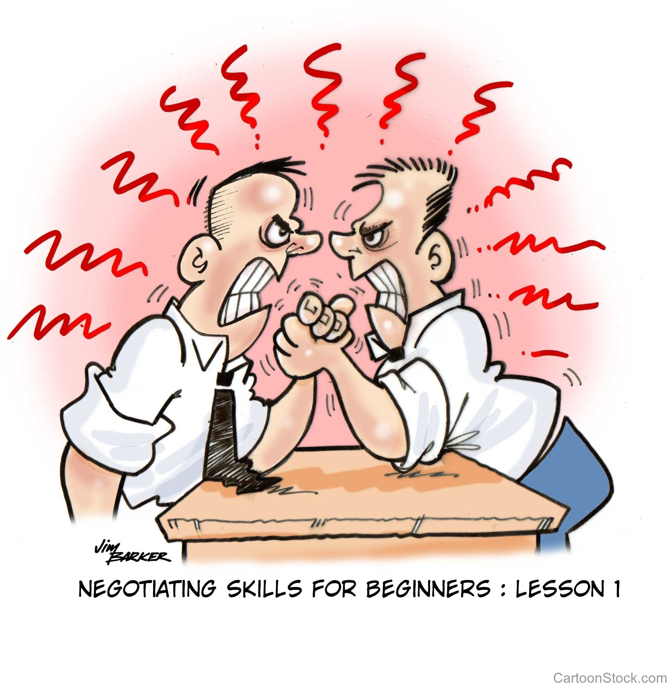
Discussion Scenario
During the open session in one monthly meeting, a younger Nasir raised the argument that Jama’at members are too antagonistic while performing Tabligh. We need to be mindful of feeling of others and not bring up topics which may hurt other’s feelings. For example, there is no need to bring up death of Jesus while talking to Christians. Another older Nasir felt strongly, that we should not hesitate in mentioning the truth, no matter what. The Za’im tried to reconcile the argument.

Slide 11
Discussion
Za’im should agree with the younger Nasir and advise the members to stay away from “sensitive” topics?
Za’im should agree with the relatively older Nasir and advise the members to not hesitate in telling the truth “no matter what”?
Za’im should stop the discussion immediately to avoid confrontation?
Any other suggestion?

Slide 12
Guidance from Friday Sermon
“It should be remembered that the concept of death of Jesus is not merely an ideological concept. It is most important as regards upholding the Oneness/Unity of God. By establishing death of Jesus the Promised Messiah removed any hindrance to the concept of perfect Oneness of God. Once someone mentioned to the Promised Messiah (on whom be peace) to ease off the concept of death of Jesus. The Promised Messiah (on whom be peace) reacted rather majestically and said this concept had caused great harm to Islam and it needed to be quelled”.
Bottom line is that we not compromise on important principles but use the guidance provided by the Holy Quran and use wisdom in our approach in Tabligh. We should not shy away from talking about death of Jesus but with wisdom.

Slide 13
1. We need to inculcate this in our hearts even today that our practices should be such that people are instantly able to recognize us as Ahmadis and find us better than others. If anyone seeks to invite the world towards Allah, should have the demeanor of a true believer. 2. When an Ahmadi faced a lot of opposition in their area, the Promised Messiah (on whom be peace) always said that this was a sign of progress for the area. Through opposition people who do not know about us find out who we are and when they read our books the truth captures their heart. 3. Man can imbue Divine attributes on a human level. Indeed the most excellent example of this was the person of Holy Prophet (peace and blessings of Allah be on him).
Take Home Message

Slide 14
What to discuss with your family?
Pick one of the following topics from this Friday sermon to discuss with children/family during casual discussion:
Have a discussion with your family about common Tabligh topics. Make sure to study appropriate references to have sound knowledge.
As as family, find out ways to spread the message of Islam/Ahmadiyyat.
Tips to engage youth in conversation: (1) Give them more talking time, and (2) use examples from Huzur’s (may Allah be his helper) sermon to make a point.

Slide 15
Did you know?
When did the Promised Messiah (peace be on him) write the book Asmani Faisalah (The Heavenly Decree)?
What is the background of this book?
What is the main subject matter of Asmani Faisalah?

Slide 16
Answers
The Heavenly Decree was written in 1891
He wrote this book after returning from Delhi and it was read by Maulvi Abdul Karim sahib in front of members who were invited by the Promised Messiah (peace be on him) to discuss the best method of putting into practice the proposals made in the book
He described the ways in which a chosen one of God can be recognized by the people
To test acceptance of prayers, the Promised Messiah (peace be on him) suggested the setting of a body which should publicly invite the most afflicted ones of any faith to send in their names and full particulars, and then the parties after dividing the afflicted people by lot, should pray for the betterment of the batch. Unfortunately, none of the opponents accepted the challenge

Slide 17
Salat page
“Ahmadis should not fall prey to any kind of feeling of low-esteem. The Holy Quran reminds us to safeguard our prayers, make it regular and watch over it, especially those prayers that fall during times of other business. Huzur (may Allah be his helper) also reminded us that Salat should be offered with complete attention towards God and worldly thoughts should not occupy our minds, which can be achieved by focusing on God and making the intention of following God’s every commandment. When this state is achieved, God Almighty says that these prayers will protect you and prevent you from committing any wrong doings and will fill our homes with blessings and favors of God Almighty.”.
(Friday Sermon June 22, 2012 delivered by Hazrat Mirza Masroor Ahmad (may Allah be his helper))

Slide 18
Health Topic
Health Risk of Pet Ownership

Slide 19
Are you Aware?
Pet ownership particularly of dogs and cats and sometimes other exotic pets can pose health risks to the entire family
Besides the challenges of basic hygiene in our homes there are specific health risks posed to humans
Campylobacter (bacteria) is one of the most common causes of diarrhea in US. Most cases are caused by eating contaminated foods. It can also be transmitted by infected dog and cat feces
According to PetMD, around 49% of dogs and 45% of stray cats carry and shed it in their feces. It is most common in puppies and kittens younger than 6 months

Slide 20
Pet Ownership
Several types of worm infestation can result from coming in touch with infected cats’ and dogs’ feces
Rabies is most dangerous disease that one contract from cats and dogs
Toxoplasmosis is contracted through cat feces and those at high risk are the pregnant, elderly and the ones with weakened immune system
Prevention of such diseases exposure includes pet vaccination, strict hygiene and preferably pets not live inside the house

Slide 21
That’s all folks
Reminders/Announcements
Dua
Jazakumullah for Participating!
If you enjoyed it, please convey to those brothers who are not here today!

