Slide 1
Majlis Ansarullah Monthly Meeting
July 2020
This slide deck contains images licensed for the purpose of this presentation only. No one is permitted to use the images for any other use, without prior permission.

Slide 2
AGENDA
Recitation of the Holy Quran (4:35)
Pledge
Sermon of the month: Some Social Evils Which Hinder Creation of Heaven in Homes and Intuitive Commentary of Qaw’wam (2/07/1986)
Verse from the Sermon
Advice from the sermon
Discussion scenario
Did you know?
Salat page
Health Tip
Free time slot for local topics
Reminders/announcements
Dua

Slide 3
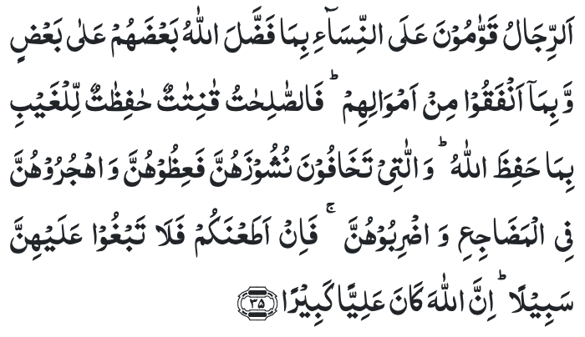
Recitation of the Holy Quran
Men are guardians over women because Allah has made some of them excel others, and because they (men) spend of their wealth. So virtuous women are those who are obedient, and guard the secrets of their husbands with Allah’s protection.
And as for those on whose part you fear disobedience, admonish them and leave them alone in their beds, and chastise them. Then if they obey you, seek not a way against them. Surely, Allah is High, Great. (4:35)

Slide 4
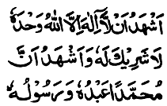
Ansar Pledge
Say this part three times:
Ash-hadu • alla ilaha • illallahu • wahdahu • la sharika lahu • wa ash-hadu • anna Muhammadan • ‘abduhu • wa rasuluh
Say this part once:
I bear witness • that there is none worthy of worship • except Allah. • He is One • (and) has no partner, • and I bear witness • that Muhammad (peace be upon him) • is His servant • and messenger.
Say this part once:
I solemnly pledge • that I shall endeavor • throughout my life • for the propagation • and consolidation • of Ahmadiyyat in Islam, • and shall stand guard • in defense of • the institution of Khilafat. • I shall not hesitate • to offer any sacrifice • in this regard. • Moreover, • I shall exhort my children • to always remain dedicated • and devoted • to Khilafat. • Insha’allah.

Slide 5
Some Social Evils Which Hinder Creation of Heaven in Homes and Intuitive Commentary of Qaw’wam Friday Sermon, February 7, 1986
Friday Sermon

Slide 6
Discussion on verse
What is the meaning of Qaw’wam?
Who should have the right to be Qaw’wam and why?
What is the significance of the attributes of “High" and “Great” used in this verse?

Slide 7
Commentary
Qaw’wam means one who manages affairs well; a ruler or governor; one in a position to issue orders
It is natural and fair that he who earns and supplies the money should have the final say in the disposal of affairs
If they are being considered high in comparison to their wives, there is One who is High and Great above all and He shall call husbands to account for any improper use of qualified authority (Five volume commentary)

Slide 8
1. True and perfect morals can only be learnt from Prophet Muhammad (peace and blessing of Allah be upon him). And the Nations that are not connected with Prophet Muhammad (peace and blessings of Allah be upon him), whether they belong to any Ism, religion or any community, they certainly will have flaws in their basic morality. 2. If we are true followers of Prophet Muhammad (peace and blessing of Allah be upon him), as we claim, no one would be able to raise any finger at any Ahmadi’s morals to point out his crookedness or evil in him. 3. The people of the first generation – the eldest generation, reformation should start from there. Then they should try to teach similar good morals to their sons and daughters, and daughters-in-law and sons-in-law. 4. The core meaning of Qaw’wam, as described by Promised Messiah (peace be on him), is that the man’s first and foremost responsibility is to create an environment of happiness in the home. His responsibility is not to correct others by force.
Synopsis of the Sermon

Slide 9
Open Discussion
As a Nasir, which aspect of this Friday Sermon, can I benefit the most from?
Share your thoughts!

Slide 10
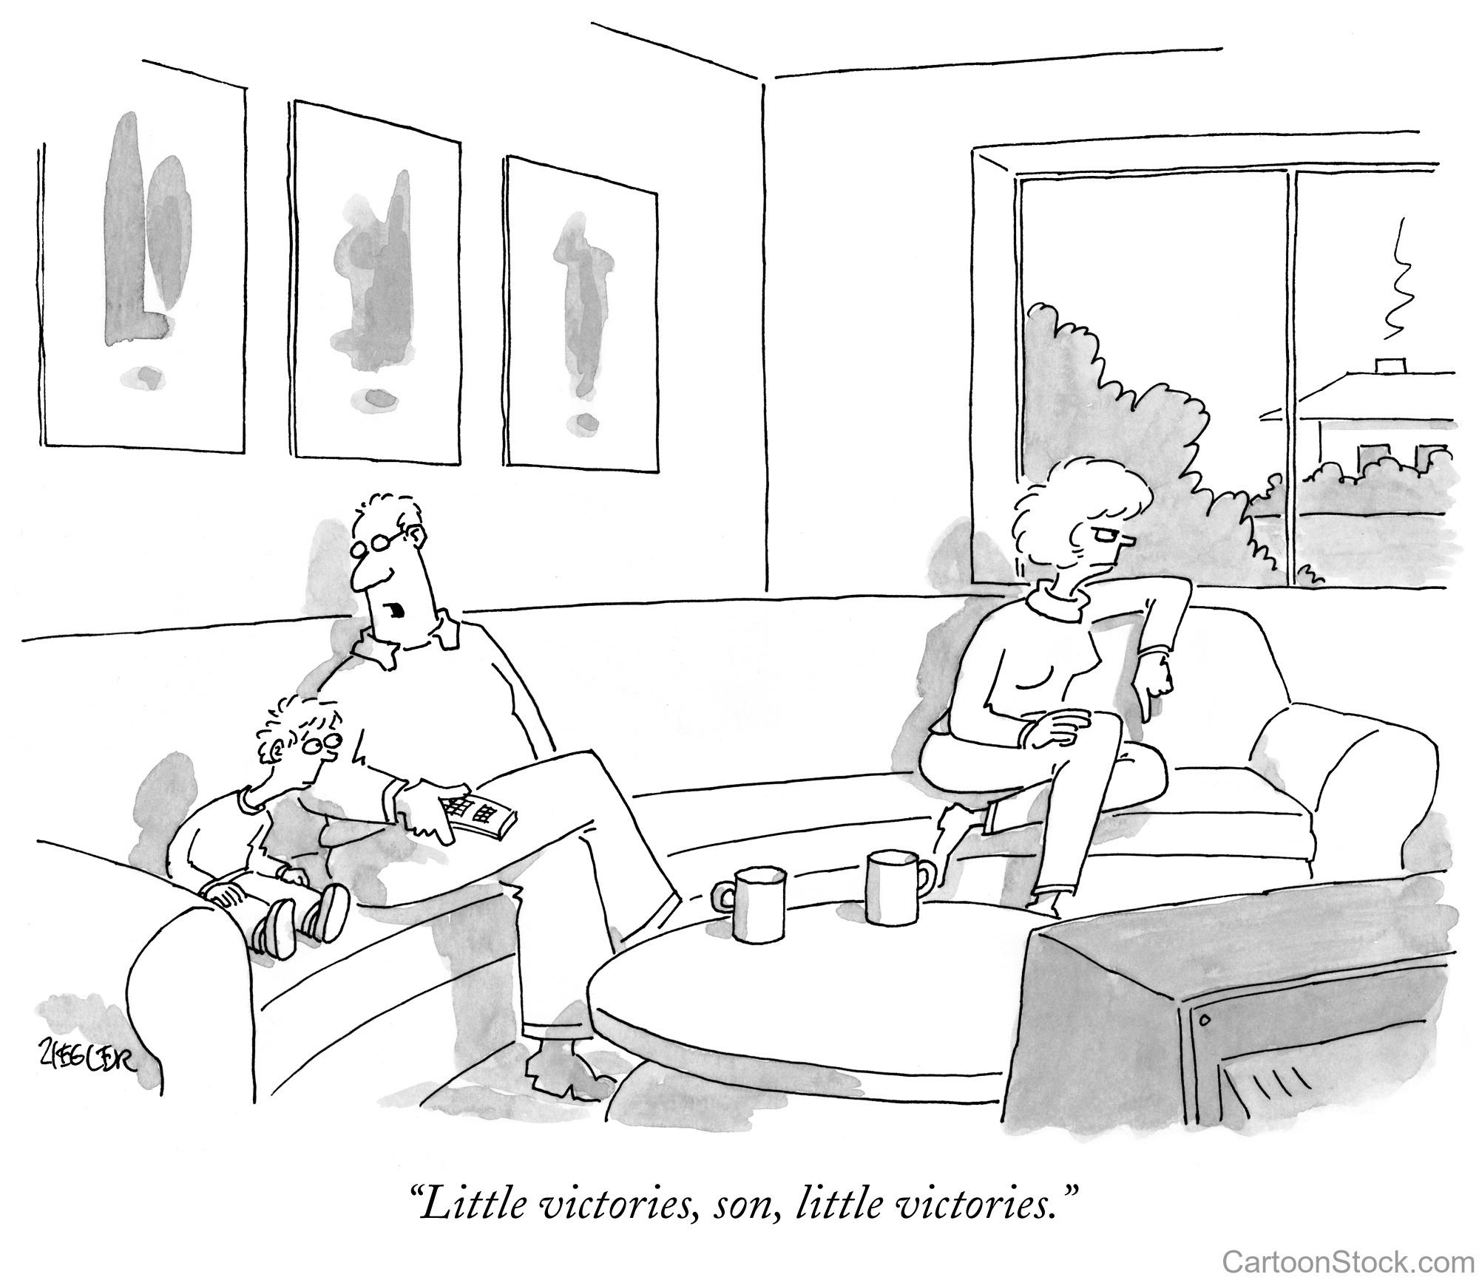
Discussion Scenario
A Nasir was advising his son before his marriage. He explained, man is the head of the household and is the guardian over his wife. The Nasir told his son to make sure he maintains discipline in the household and that his wife is obedient to him. The Nasir’s wife, whom he did not get along very well, jumped into the discussion and argued that this was not the right approach. She suggested that their son needs to take a lenient approach. The Nasir got upset and started quoting the “Qaw’wam” verse to her.

Slide 11
Discussion
Do you agree with the Nasir as men are indeed Qaw’wam according to the teaching of the Holy Quran?
Do you agree with the Nasir’s wife in that the son should not be too strict?
Do you think that the concept of man being the head of the household is outdated?
In your opinion what is the best way to ensure that you lead your household?

Slide 12
Guidance from Friday Sermon
“This is where the meaning of Qaw’wam opens up. Qaw’wam does not mean, man do whatever he likes to do and control woman by the force of stick. Qaw’wam means man must correct himself because whatever he does women are influenced by their husbands. As they get influence, so it is important for husbands to correct themselves and thus promulgate the effect of that correction among the wives.”
Bottom line is that men are indeed the Qaw’wam and head of the household. However, this does not mean use of force or unnecessary strictness. They will have to lead with personal example and prayer. They can setup household principles after discussion and agreement with their wives.

Slide 13
1. We should not simply become happy on account of being an Ahmadi and connected to the most perfect human on earth, i.e. Holy Prophet (peace and blessings of Allah be upon him). Our everyday action should reflect it. 2. It is very important to pay attention, very detailed efforts are necessary to correct the atmosphere of our homes. True and perfect morals can only be learnt from Prophet Muhammad (peace and blessing of Allah be upon him). 3. Qaw’wam does not mean, man do whatever he likes to do and control woman by the force of stick. Qaw'wam means man must correct himself because whatever he does women are influenced by their husbands.
Take Home Message

Slide 14
What to discuss with your family?
Pick one of the following topics from this Friday sermon to discuss with children/family during casual discussion:
Reflect on your life if you fit the criteria of Qaw’wam as mentioned in the sermon and writings of Promised Messiah (peace be on him).
Have a frank discussion with your sons about the true meaning of Qaw’wam in light of this Friday sermon.
Tips to engage youth in conversation: (1) Give them more talking time, and (2) use examples from Huzur’s sermon (may Allah be his helper) to make a point.

Slide 15
Did you know?
When was the book Izala-e-Auham (The removal of misconceptions) written by the Promised Messiah (peace be on him)?
What is the background of this book?
What are some of the subjects discussed in this book?

Slide 16
Answers
The Promised Messiah (peace be on him) wrote this book in 1891. This book was written in two parts
This book is a continuation of earlier two books, Fathe Islam and Taudih-e-Maram.
The book begins with a comparison of the miracles shown by Jesus and the Promised Messiah (peace be on them)
The book also included a commentary on 30 verses of the Holy Quran and a number of well-known Ahadith to prove that Jesus Christ died a natural death. The Promised Messiah (peace be on him)also discussed the true import of the words Nuzul and Tawaffi and the reality of Gog and Magog
Part II of the book, among other things, laid down ten conditions of the bai‘at.

Slide 17
Salat page
"Recite that which has been revealed to thee of the Book, and observe Prayer. Surely, Prayer restrains one from indecency and manifest evil, and remembrance of Allah is the greatest virtue. And Allah knows what you do." (29:46)

Slide 18
Health Topic
Fats or Sugar;
What is worse

Slide 19
Health Topic
Excess of both fat and Sugars are bad for you says the American Heart Association
What Fats are bad for you - Saturated fats and trans fats are bad for you, they are found primarily in animal products and certain exotic oils derived from plants, including coconut oil and palm oil
Trans fats are bad for you and not found in nature
Not all Fats are bad - It is good to use monounsaturated fats in moderation in diet, OLIVE OIL, CANOLA OIL, AVOCADO OIL, and nuts
Omega-3 fatty acids reduce risk of blood clots and lower inflammation; e.g. salmon sardines, walnuts and flax-seeds are good sources.
Omega-6 fats build healthy cells and nerve fibers. Sources include soybean, corn, sunflower and safflower oils.

Slide 20
Health Topic
Sugars that occur in nature such as those found in milk and are good as part of balanced diet. Fruits are great but fruit juices not so much
Excess added sugar in food (Sucrose) is associated with increased risk of diabetes, obesity and high cholesterol.
Food Labels can be deceptive too. Low Sugar food may be very high in fat. In General the less processed food, the less sugars and choosing healthy fats is the best health strategy

Slide 21
That’s all folks
Reminders/Announcements
Dua
Jazakumullah for Participating!
If you enjoyed it, please convey to those brothers who are not here today!

